Slide 1
Developing a Winning Strategy for Library Facilities Management in Three Easy Steps . . . Well, More Than Three, But Who’s Counting . . .

Slide 2
Candle Wester
Associate Director of Faculty Services & Administration, University of South Carolina School of Law.
Sandra B. Placzek
Associate Director & Professor of Law Library, Schmid Law Library University of Nebraska College of Law.

Slide 3
Facilities Management

Slide 4
The Tale of Two Libraries

Slide 5
Small or Medium

Slide 6
Who you gonna call?
Show Me the Money

Slide 7
Small or Medium
One BMR
Team

Slide 8
Custodial
University Service Desk, Building Manager, custodial supervisor, or speak directly to cleaning crew.
University pays unless outside normal schedule.
Communicate & build relationships.

Slide 9
Custodial
University Service Desk, Submit Work Order, OR contact Building Manager.
University pays sometimes OR request estimate and department pays.
Building System Maintenance

Slide 10
Custodial
Call or email University Service Desk OR Building Manager.
University pays.
Communicate & build relationships.
Building Upkeep
Building System Maintenance

Slide 11
Physical . . .
Theoretical. . .
Practical . . .
Can we do anything to have more control over the use of our space?

Slide 12
Communicate
Set up channels of communication with major stake holders;
Clearly communicate use policies and expectations;
Make a big deal out of using library space;
Reminder: the library is a primarily a study space for students; event’s impact;
“In Use”.

Slide 13
Communicate
Try to set strict boundaries for certain spaces as student use only;
Make a big deal out of using library space if it will disrupt students.
Advocate for students

Slide 14
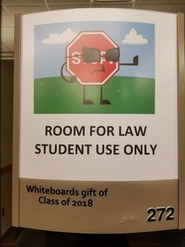
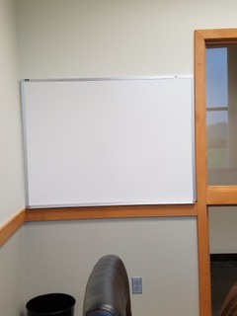

Slide 15
s
Communicate
Keep abreast of changes in other libraries;
Don’t limit yourself in the “we’ve always done it that way” box – make changes where/when relevant;
Think of ways to use the space and make proposals; be the instigator of changes.
Advocate for students
Stay informed; be the change

Slide 16
Communicate
“Don’t have a cow man”.
Invite/encourage use of your space in ways that you think will be least disruptive.
Be Flexible
Advocate for students
Stay informed; be the change

Slide 17
Communicate
Host events.
Participate in law college events.
Showcase the library, the librarians, and the staff.
Training sessions.
Create newsletter and annual reports.
Be Flexible
Advocate for students
Be Visible
Stay informed; be the change

Slide 18
Who
How
Library space use
What
Why
When
Where

Slide 19
This Photo by Unknown Author is licensed under CC BY-SA

Slide 20
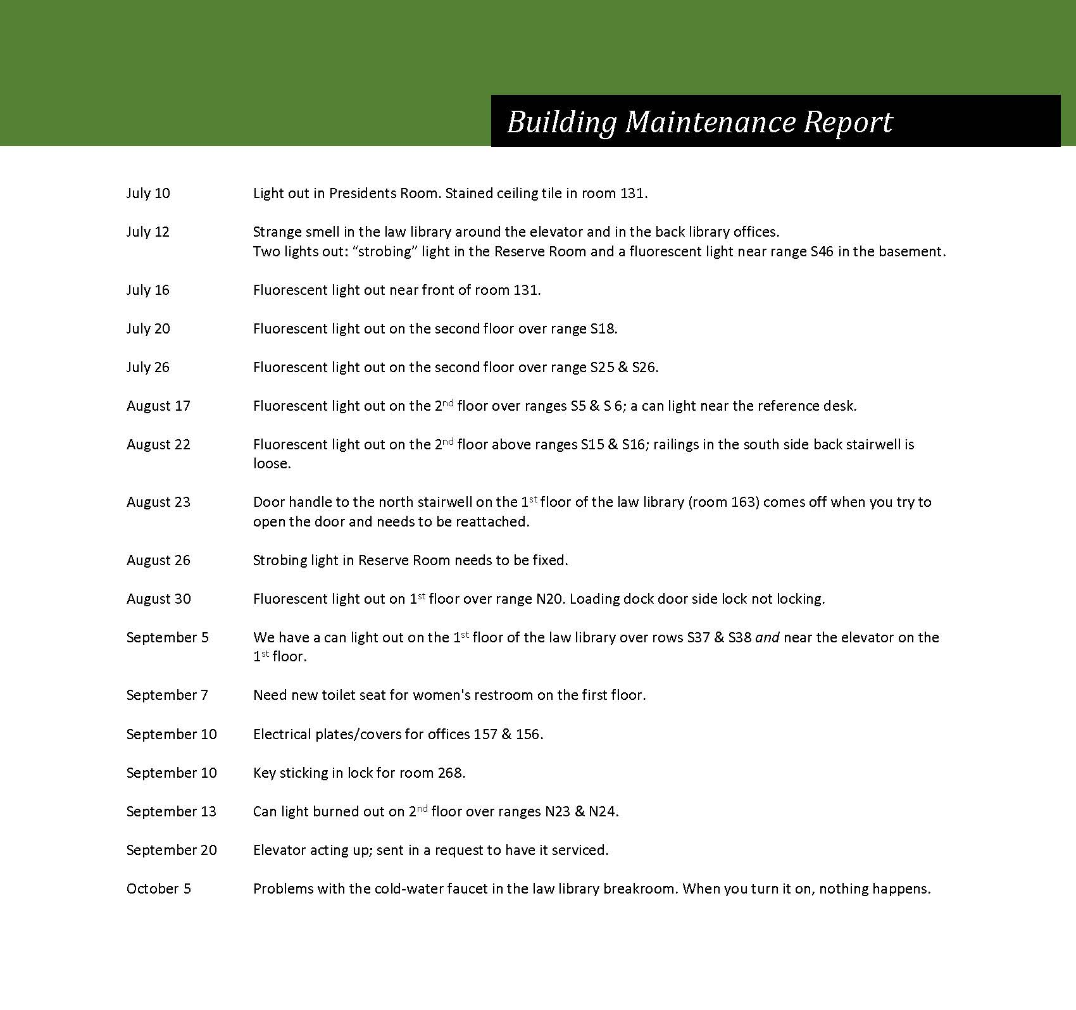

Slide 21
February 2018
February | 136 | 137 | 165 | 166 | 268 | 269 | 271 | 272 | 244 | 243 | 240 | 239 | totals
7:30 - 8:00 am | 1 |  |  |  |  |  |  |  |  |  | 2
8:00 - 9:00 am | 3 | 6 | 2 | 3 | 1 |  |  | 3 | 4 | 4 | 2
9:00 - 10:00 am | 5 | 5 | 2 | 8 | 1 | 1 |  | 2 | 7 | 6 | 4 | 3
10:00 - 11:00 am | 11 | 13 | 14 | 11 | 3 | 5 | 6 | 17 | 9 | 12 | 14 | 15
11:00 am - noon | 12 | 14 | 14 | 15 | 7 | 3 | 7 | 10 | 13 | 13 | 14 | 19
noon - 1:00 pm | 18 | 17 | 16 | 18 | 8 | 11 | 15 | 16 | 20 | 18 | 17 | 17
1:00 - 2:00 pm | 20 | 18 | 16 | 15 | 13 | 14 | 15 | 18 | 21 | 24 | 19 | 19
2:00 - 3:00 pm | 21 | 22 | 17 | 20 | 16 | 19 | 17 | 17 | 24 | 26 | 24 | 21
3:00 - 4:00 pm | 16 | 22 | 16 | 14 | 17 | 19 | 13 | 13 | 21 | 24 | 23 | 20
4:00 - 5:00 pm | 13 | 18 | 15 | 14 | 13 | 14 | 9 | 11 | 17 | 23 | 20 | 22
5:00 - 6:00 pm | 9 | 12 | 6 | 7 | 7 | 11 | 8 | 6 | 12 | 15 | 14 | 15
6:00 - 7:00 pm | 3 | 6 | 4 | 3 | 1 | 4 | 5 | 5 | 8 | 8 | 9 | 7
7:00 - 8:00 pm | 3 | 2 | 1 | 7 |  | 5 | 2 | 5 | 7 | 4 | 5 | 7
8:00 - 9:00 pm | 3 |  | 1 | 11 |  | 2 | 1 | 5 | 3 | 2 | 5 | 7
9:00 - 10:00 pm | 2 |  | 1 | 11 |  | 2 | 1 | 2 | 2 | 1 | 6 | 4
10:00 - 11:00 pm | 1 |  | 1 | 9 |  |  |  | 1 |  |  | 2 | 3
11:00 - 12:30 pm | 1 |  |  | 2 |  |  |  |  |  |  | 2 | 2
1729 | 142 | 155 | 126 | 168 | 87 | 110 | 99 | 131 | 168 | 180 | 182 | 181 | 1729
March | 136 | 137 | 165 | 166 | 268 | 269 | 271 | 272 | 244 | 243 | 240 | 239 | totals

Slide 22
August/September 2017
August/September 2017 totals
Date/Day |  | Closing | Total In | Last 2 hours - In | Last 2 hours - Out | Final headcount (last hour) | Misc |  | Averages
23-Aug | Wed | 11 | 356 | 10 | 8 | 0 |  |  | Mon | 528
24-Aug | Thu | 10 | 732 | 9 | 7 | 1 | Classes start |  | Tue | 679
25-Aug | Fri | 9 | 225 | 6 | 10 | 0 |  |  | Wed | 647
26-Aug | Sat | 9 | 91 | 9 | 8 | 3 |  |  | Thu | 609
27-Aug | Sun | 11 | 168 | 5 | 5 | 1 |  |  | Fri | 304
28-Aug | Mon | 11 | 755 | 17 | 10 | 0 |  |  | Sat | 93
29-Aug | Tue | 11 | 828 | 11 | 15 | 3 |  |  | Sun | 110
30-Aug | Wed | 11 | 915 | 17 | 18 | 4
31-Aug | Thu | 10 | 664 | 1 | 7 | 2
1-Sep | Fri | 7 | 262 | 8 | 5 | 10 | Labor Day
2-Sep | Sat | 6 | 59 | 0 | 4 | 6 | Labor Day
3-Sep | Sun | 9 | 65 | 0 | 1 | 3 | Labor Day
4-Sep | Mon | 9 | 110 | 9 | 25 | 5 | Labor Day
5-Sep | Tue | 11 | 686 | 12 | 15 | 1
6-Sep | Wed | 11 | 689 | 14 | 24 | 5
7-Sep | Thu | 10 | 585 | 14 | 19 | 3
8-Sep | Fri | 9 | 345 | 11 | 16 | 0
9-Sep | Sat | 9 | 102 | 6 | 5 | 0
10-Sep | Sun | 11 | 87 | 3 | 7 | 1
11-Sep | Mon | n/a | n/a | n/a | n/a | n/a | CLOSED
12-Sep | Tue | 11 | 547 | 6 | 10 | 2
13-Sep | Wed | 11 | 607 | 14 | 20 | 2
14-Sep | Thu | 6 (to public) | 495 | 61 | 75 | 0 | *Gala
15-Sep | Fri | 9 | 384 | 27 | 18 | 1
16-Sep | Sat | 9 | 85 | 5 | 7 | 1
17-Sep | Sun | 11 | 112 | 2 | 9 | 0
18-Sep | Mon | 11 | 632 | 4 | 9 | 3
19-Sep | Tue | 11 | 709 | 16 | 23 | 5
20-Sep | Wed | 11 | 678 | 26 | 35 | 7
21-Sep | Thu | 10 | 579 | 9 | 16 | 3
22-Sep | Fri | 9 | 363 | 3 | 5 | 0
23-Sep | Sat | 9 | 73 | 27 | 26 | 5
24-Sep | Sun | 11 | 119 | 10 | 15 | 2
25-Sep | Mon | 11 | 615 | 9 | 8 | 1

Slide 23
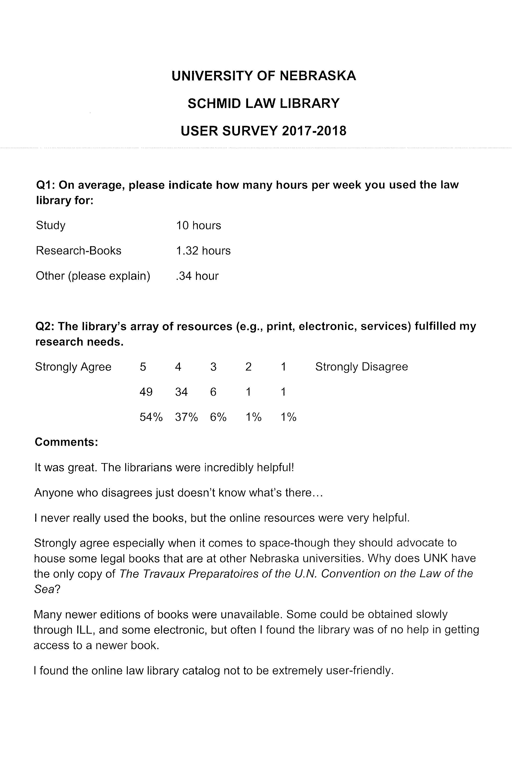
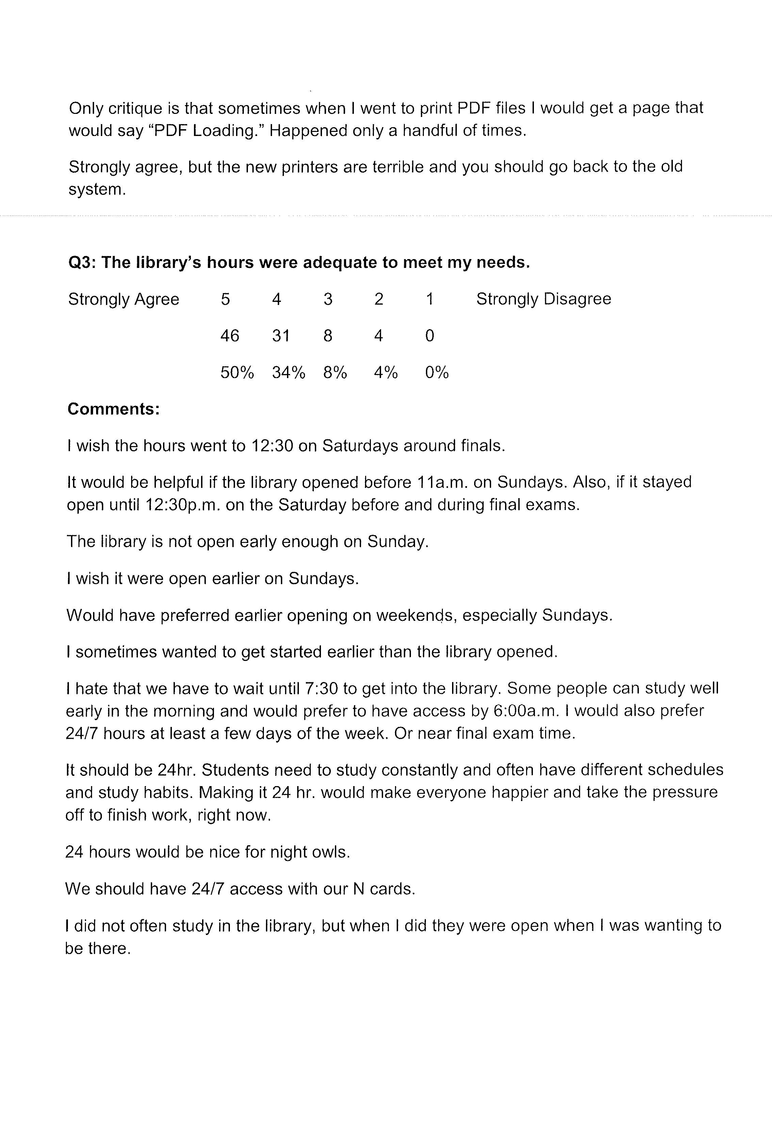

Slide 24
Planning for the unknown
This Photo by Unknown Author is licensed under CC BY-NC-ND

Slide 25
Developing a Winning Strategy for Library Facilities Management in Three Easy Steps . . .
Notes:
So we entitled this presentation . . .
We hope we’ve given you some ideas to build your own facilitities management strategy. In summary, I think if you ask Candle and I, we’d say that the 3 steps we think are most relevant from the presentation – the three takeaways are:
Communicate – understand how important communication is with BOTH your stakeholders and those individuals who maintain your facility
Be FLEXIBLE and think about where you want your library to go – and how to get it there.
FINALLY – build data not only to help you get where you want to be, but to support the policies that you implement.

Slide 26
Questions?

