Slide 1
Setting the Pace: Best Practices for Online Teaching

Slide 2
Setting the Pace: Best Practices for Online Teaching
John Edwards, Associate Dean for Information Resources and Technology and Professor of Law, Drake University Law School
Dorie Knight, Reference and Instruction Librarian and Assistant Professor of Law Librarianship, Drake University Law School
Joseph Custer, Director of Law Library and Associate Professor of Law, Case Western Reserve University School of Law
Rich Leiter, Director of Law Library and Professor of Law, University of Nebraska Law School

Slide 3
Setting the Pace: Best Practices for Online Teaching
Key Considerations in an Online Setting – Dorie Knight
Teaching Successfully in a Virtual and HyFlex Classroom – Joe Custer
Effective Tools for Connecting with Distanced Students – Rich Leiter
Q & A
Feel free to submit questions in Chat. We plan to allow time for questions at the end of each presentation.

Slide 4
Key Considerations in an Online Setting
DORIE KNIGHT

Slide 5
Synchronous CLASSES
Pros
Cons
Live interaction
Can create activities to do together
Perform comprehension checks of students
Doesn't have flexibility
Need to be very capable with the technology
Live Streaming requires a lot of bandwidth
Technology issues can increase stress

Slide 6
ASYNCHRONOUS CLASSES
Pros
Cons
Allows for greater flexibility
Doesn't require as much bandwidth
Can be less stressful
What you create can be used again and again
Less dynamic
Dedicate more time to creating content
Not setting boundaries for yourself
Can't replicate a discussion experience from an in-person course in an online course

Slide 7
popular do’s & Don’ts
DON’T focus on the obstacles… but try to prepare for them!
DO work on objectives and evidences first, then create the online lessons.
DON’T be afraid to try something new!
DO become over-prepared with the technology you plan to use.
DON’T create everything from scratch!
DO embed helpful links.
DO make the effort to personalize the course.
DON’T leave out opportunities for engagement.
DO promote active learning.
DON’T burn yourself out.
DO keep next semester in mind!

Slide 8
Tips for better video content
Video Length: shorter the better.
Number of subjects being covered should be limited.
Incorporate Visuals.
Good Sound and lighting!
Create a script so you can add closed captions.
Make the video for your audience, not you.

Slide 9
Creating Videos In Camtasia
COST: $169.99 for Educators (+ optional yearly $42.25 for support and guaranteed yearly upgrades.)
COMPARABLES: Adobe Premiere Pro, Final Cut Pro X, Screenflow, Filmora, Snagit, SmartPixel, EZvid, iMovie & more.
Camera & Screen recording with customizations
Many editing options to trim, filter, and add effects.
Existing library of various media.
Zoom & Pan with animation.
Annotate!
Transitions.
Export or Share directly.
Visual Demo: https://youtu.be/abcYKjZRnb8
References: https://tinyurl.com/y43vynvb

Slide 10
TEACHING SUCCESSFULLY IN A VIRTUAL AND HYFLEX CLASSROOM
JOSEPH CUSTER

Slide 11
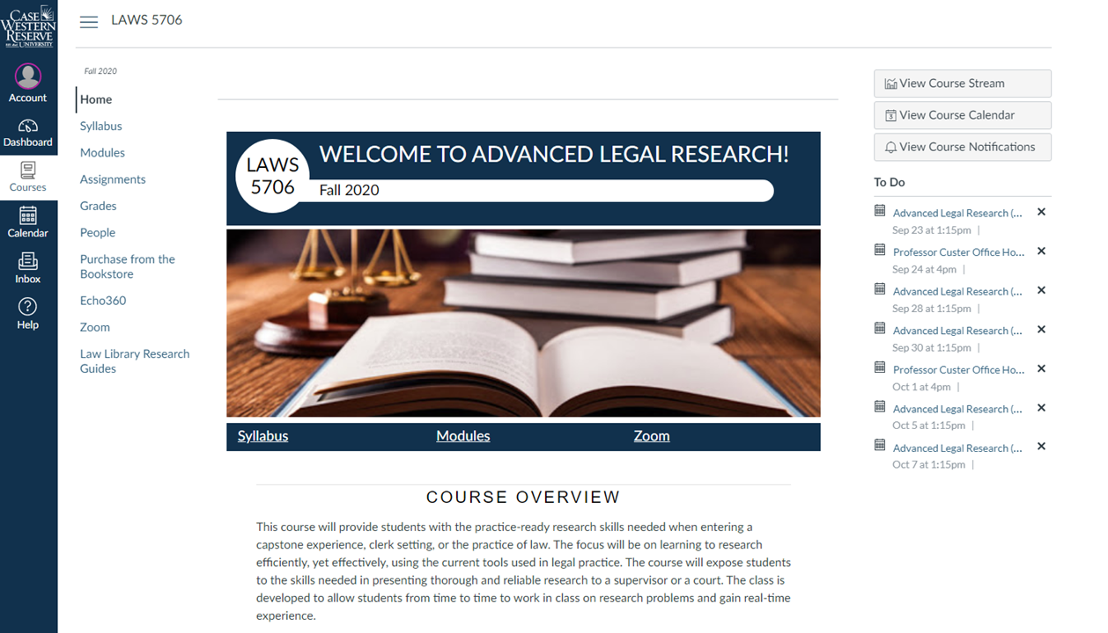

Slide 12
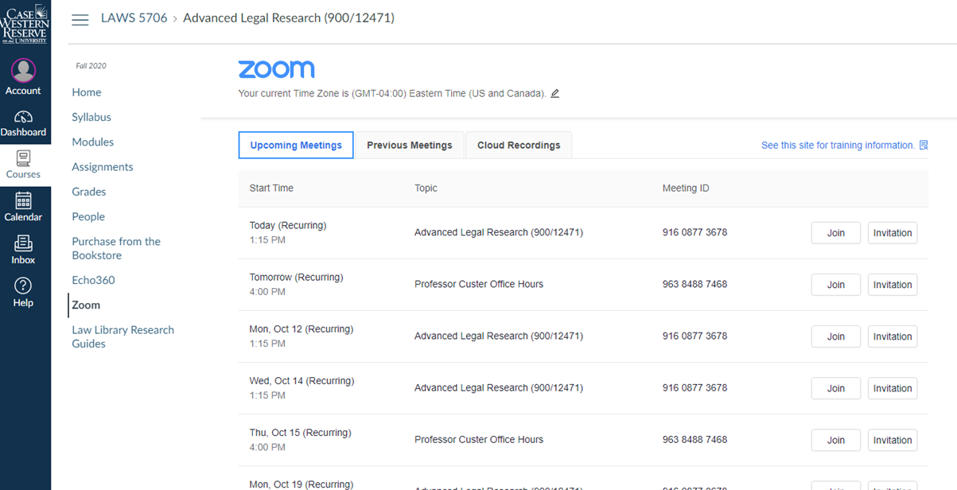

Slide 13
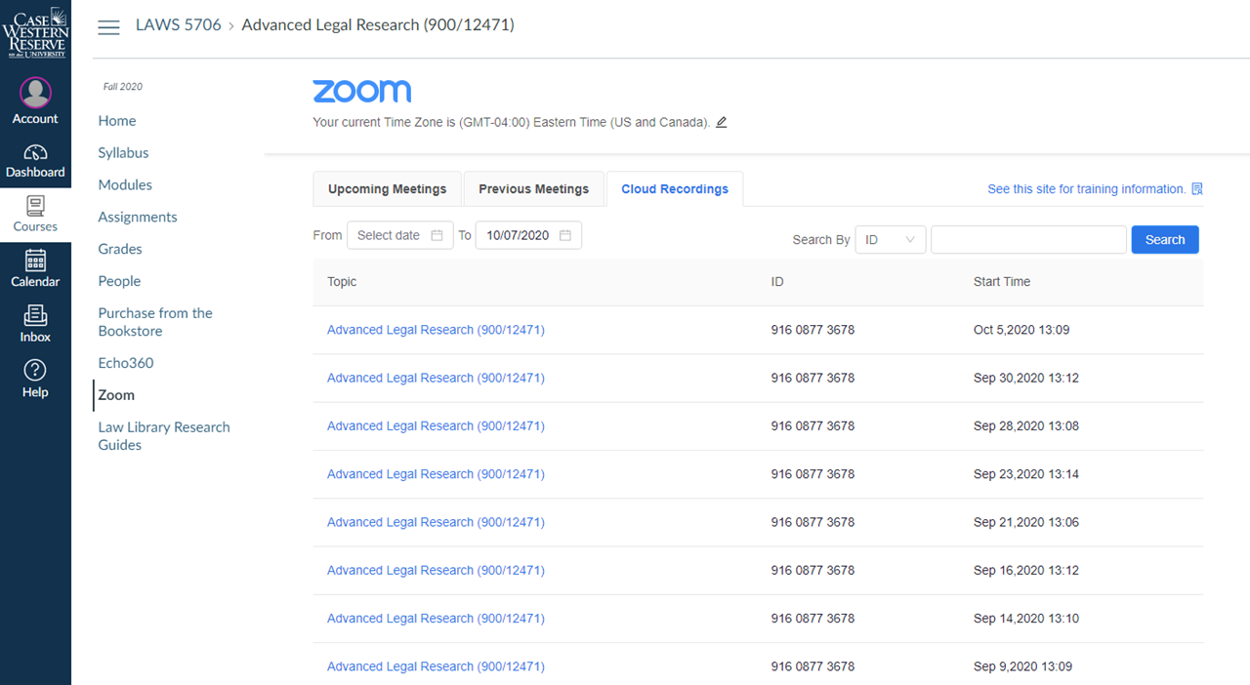

Slide 14
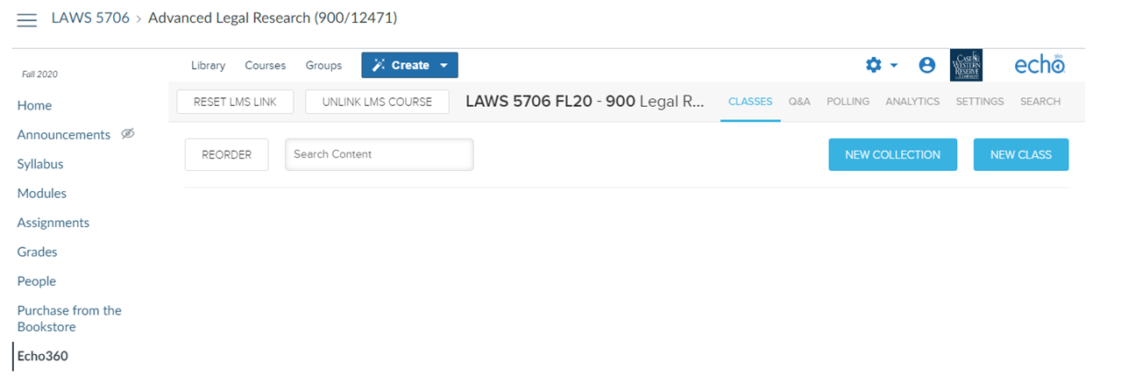

Slide 15
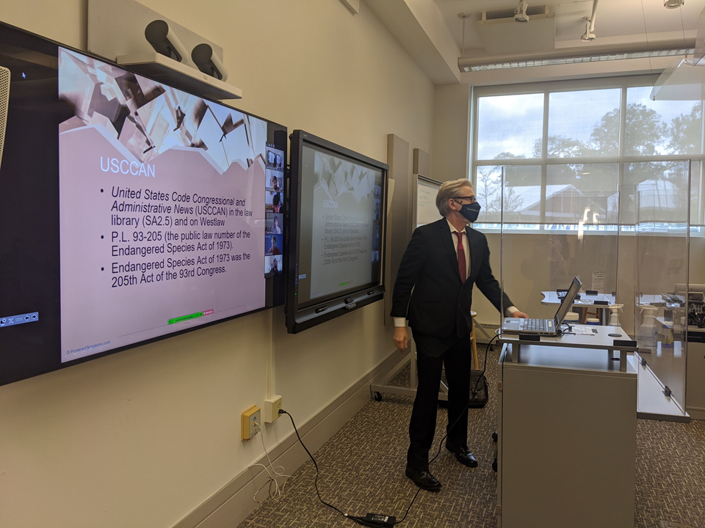

Slide 16
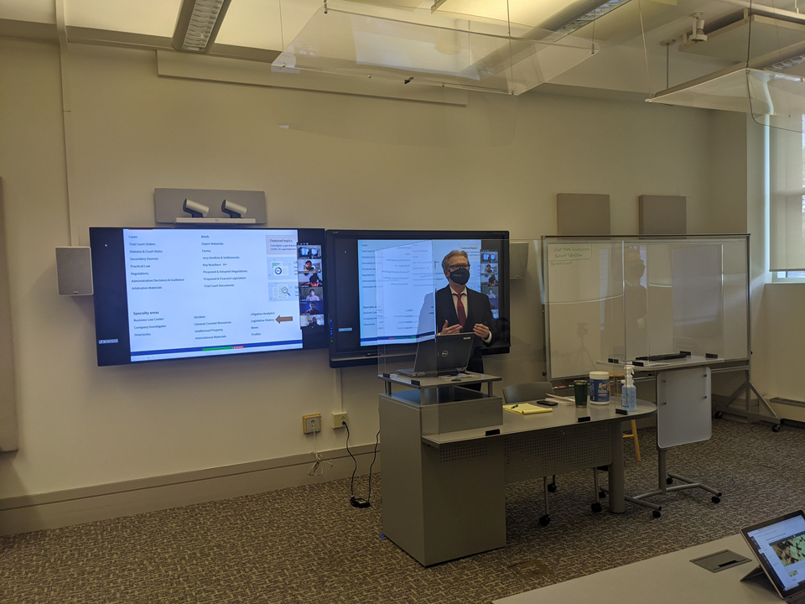

Slide 17
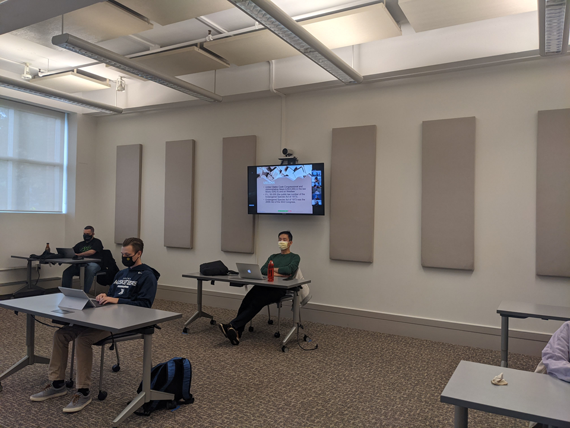

Slide 18
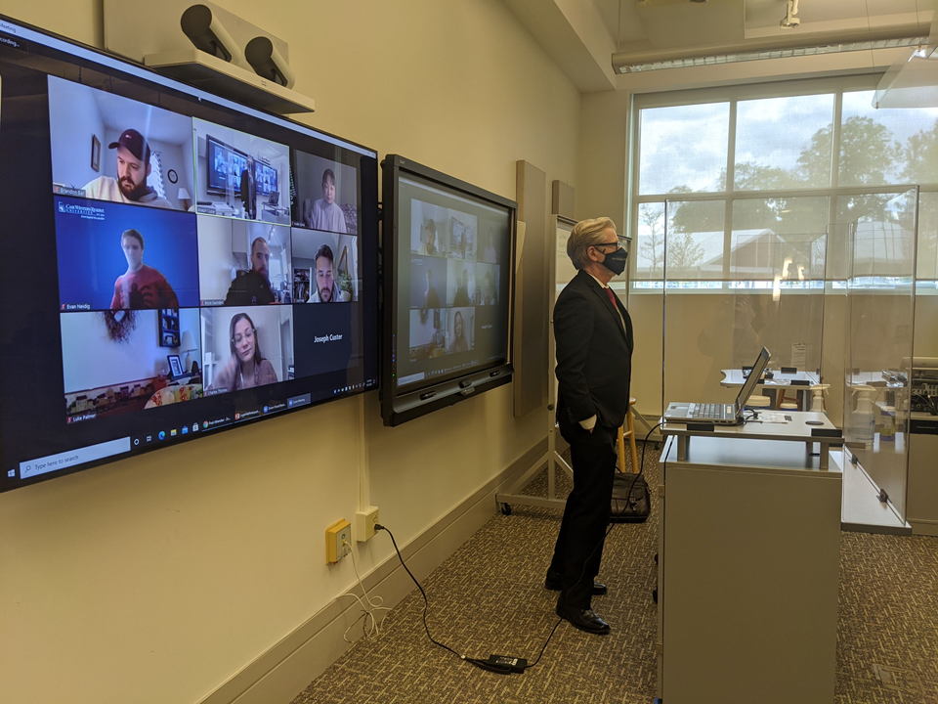

Slide 19
Video #1 https://youtu.be/642Jg2e5FAQ
Video #2 https://youtu.be/eqeftcuydic
Notes:
https://youtu.be/642Jg2e5FAQ

Slide 20
EFFECTIVE TOOLS FOR CONNECTING WITH DISTANCED STUDENTS
RICH LEITER

Slide 21
VITTLE + IPAD (APPLE PENCIL) =
FLEXIBLE, COOL TOOL FOR REMOTE LEARNING
With a week to switch from in-person classes to online I needed an easy fix:
Vittle is one attractive and fairly easy option: http://qrayon.com/home/vittle
COST: Vittle Pocket Pro = $7.99 Vittle Pro Video Whiteboard = 24.99 (Offers discounts for educators.)
COMPARABLES: Educreations Whiteboard, Notability, Google Jamboard, & more.

Slide 24
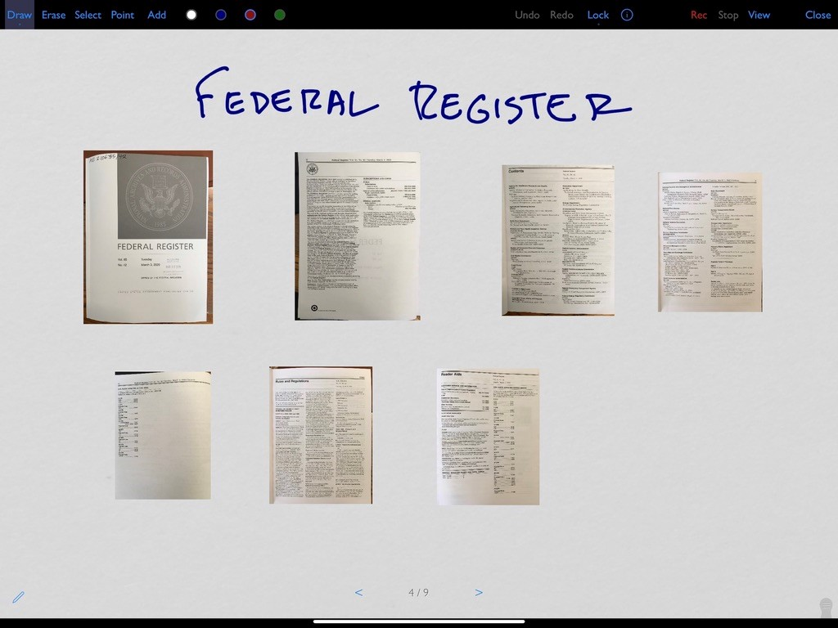

Slide 25
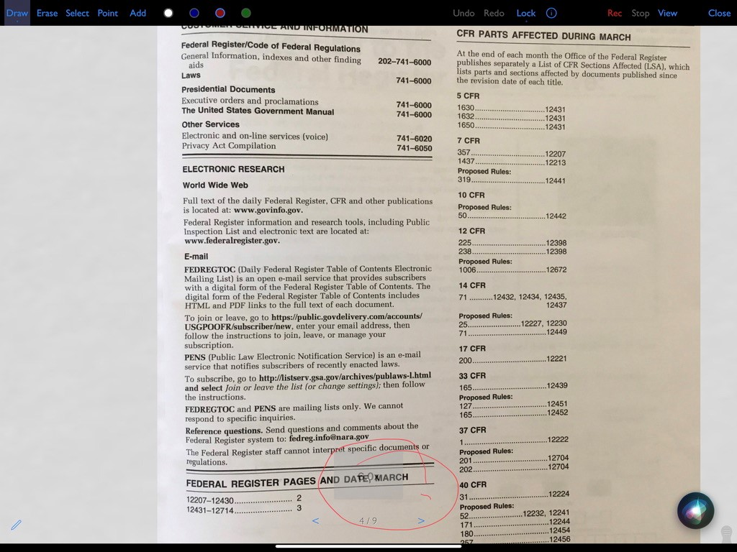

Slide 27
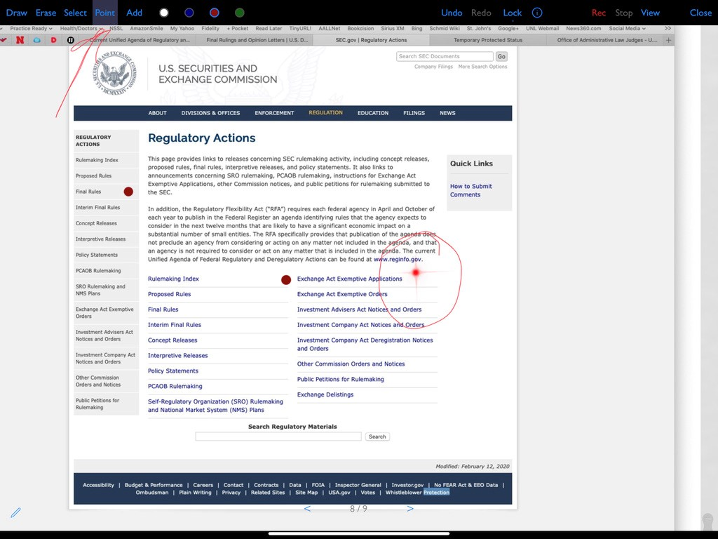

Slide 28
Q & A

