Slide 1
Spirited Teaching: Engaging Students in a Required Research Course
Joyce McCray Pearson, Moderator
Dorie Bertram
Hyla Bondareff
Aris Woodham
MAALL 2019 Meeting
St. Louis, MO

Slide 2
Introduction
Joyce McCray Pearson

Slide 3
Quimbee
Dorie Bertram

Slide 4
Fall 2018 | Fall 2019
Week 1: Ch.1 Introduction and Ch.2 Foundations of Legal Research and Writing
Week 2: [No Quimbee: Lexis & Westlaw Training]
Week 3: Ch.3 Understanding and Working with Cases (except for citator video)
Week 4: Ch.3 citator video
Week 5: Ch.4 Understanding Legislation: Statutes and Codes (except Leg. Hist., in- class focus on state statutes)
Week 6: Ch.6 Understanding Secondary Sources
Week 7: Ch.7 Systems and Tools for Legal Research
Week 8: Ch.8 Searching, Filtering and Evaluating

Slide 5
Fall 2018 | Fall 2019
Week 1: Ch.1 Introduction and Ch.2 Foundations of Legal Research and Writing | Week 1: Ch.1 Introduction and Ch2. Foundations of Legal Research and Writing
Week 2: [No Quimbee: Lexis & Westlaw Training] | Week 2: [No Quimbee: Lexis & Westlaw Training]
Week 3: Ch.3 Understanding and Working with Cases (except for Citator video) | Week 3: Ch.8 Searching, Filtering and Evaluating
Week 4: Ch.3 Citator video | Week 4: Ch.6 Understanding Secondary Sources
Week 5: Ch.4 Understanding Legislation: Statutes and Codes (except Leg. Hist., in- class focus on state statutes) | Week 5: Ch.3 Understanding and Working with Cases (except for Citator video)
Week 6: Ch.6 Understanding Secondary Sources | Week 6: Ch.3 Citator video
Week 7: Ch.7 Systems and Tools for Legal Research | Week 7: Ch.4 Understanding Legislation: Statutes and Codes (except Leg. Hist.)
Week 8: Ch.8 Searching, Filtering and Evaluating | Week 8: [No Quimbee: Job Searching]

Slide 6
Fall 2018 | Fall 2019
Week 1: Ch.1 Introduction and Ch.2 Foundations of Legal Research and Writing | Week 1: Ch.1 Introduction and Ch2. Foundations of Legal Research and Writing
Week 2: [No Quimbee: Lexis & Westlaw Training] | Week 2: [No Quimbee: Lexis & Westlaw Training]
Week 3: Ch.3 Understanding and Working with Cases (except for Citator video) | Week 3: Ch.8 Searching, Filtering and Evaluating
Week 4: Ch.3 Citator video | Week 4: Ch.6 Understanding Secondary Sources
Week 5: Ch.4 Understanding Legislation: Statutes and Codes (except Leg. Hist., in- class focus on state statutes) | Week 5: Ch.3 Understanding and Working with Cases (except for Citator video)
Week 6: Ch.6 Understanding Secondary Sources | Week 6: Ch.3 Citator video
Week 7: Ch.7 Systems and Tools for Legal Research | Week 7: Ch.4 Understanding Legislation: Statutes and Codes (except Leg. Hist.)
Week 8: Ch.8 Searching, Filtering and Evaluating | Week 8: [No Quimbee: Job Searching]

Slide 7
Fall 2018 | Fall 2019
Week 1: Ch.1 Introduction and Ch.2 Foundations of Legal Research and Writing | Week 1: Ch.1 Introduction and Ch2. Foundations of Legal Research and Writing
Week 2: [No Quimbee: Lexis & Westlaw Training] | Week 2: [No Quimbee: Lexis & Westlaw Training]
Week 3: Ch.3 Understanding and Working with Cases (except for Citator video) | Week 3: Ch.8 Searching, Filtering and Evaluating
Week 4: Ch.3 Citator video | Week 4: Ch.6 Understanding Secondary Sources
Week 5: Ch.4 Understanding Legislation: Statutes and Codes (except Leg. Hist., in- class focus on state statutes) | Week 5: Ch.3 Understanding and Working with Cases (except for Citator video)
Week 6: Ch.6 Understanding Secondary Sources | Week 6: Ch.3 Citator video
Week 7: Ch.7 Systems and Tools for Legal Research | Week 7: Ch.4 Understanding Legislation: Statutes and Codes (except Leg. Hist.)
Week 8: Ch.8 Searching, Filtering and Evaluating | Week 8: [No Quimbee: Job Searching]

Slide 8
Spring 2019 | Spring 2020 (expect to be roughly the same)
Week 1: [No Quimbee: Job Searching]
Week 2: Review Quimbee Ch.4 Understanding Legislation: Statutes and Codes (except Legislative History, in-class focus on federal statutes)
Week 3: Ch.4 Legislative History video
Week 4: Ch.5 Understanding Regulations and Administrative Law (except Administrative Decisions)
Week 5: Ch.5 Administrative Decisions video
Week 6: [No Quimbee: Bloomberg Law Training]
Week 7: [No Quimbee: Subject Matter Services (i.e., Looseleafs)]
Week 8: [No Quimbee: Forms and CLEs]

Slide 9
Grading and Course Structure
Hyla Bondareff

Slide 10
Canvas
Aris Woodham

Slide 11
History Of LMS at WashULaw
SharePoint-based Local Course Site
Minimal Functionality
Blackboard
First Fully Functional LMS
Initial use of online assessments (quizzes)
Canvas
University conversion began in 2018
Used for three semesters in Legal Research Methodologies
Advanced features including
Asssessments
Gradebooks
Student Tracking

Slide 12
Teaching Center Consultant
Primary Suggestions
Simplicity
Transparency in Assessment and Grading
Framing of content with introductory text
Use of Headers in Module Construction
Feedback timing is critical
Automate if necessary (we have!)
Self-reflective questions are important
What did you find most difficult/easiest in re this source and its features/content?
We haven’t fully expoited this technique but hope to in the future

Slide 13
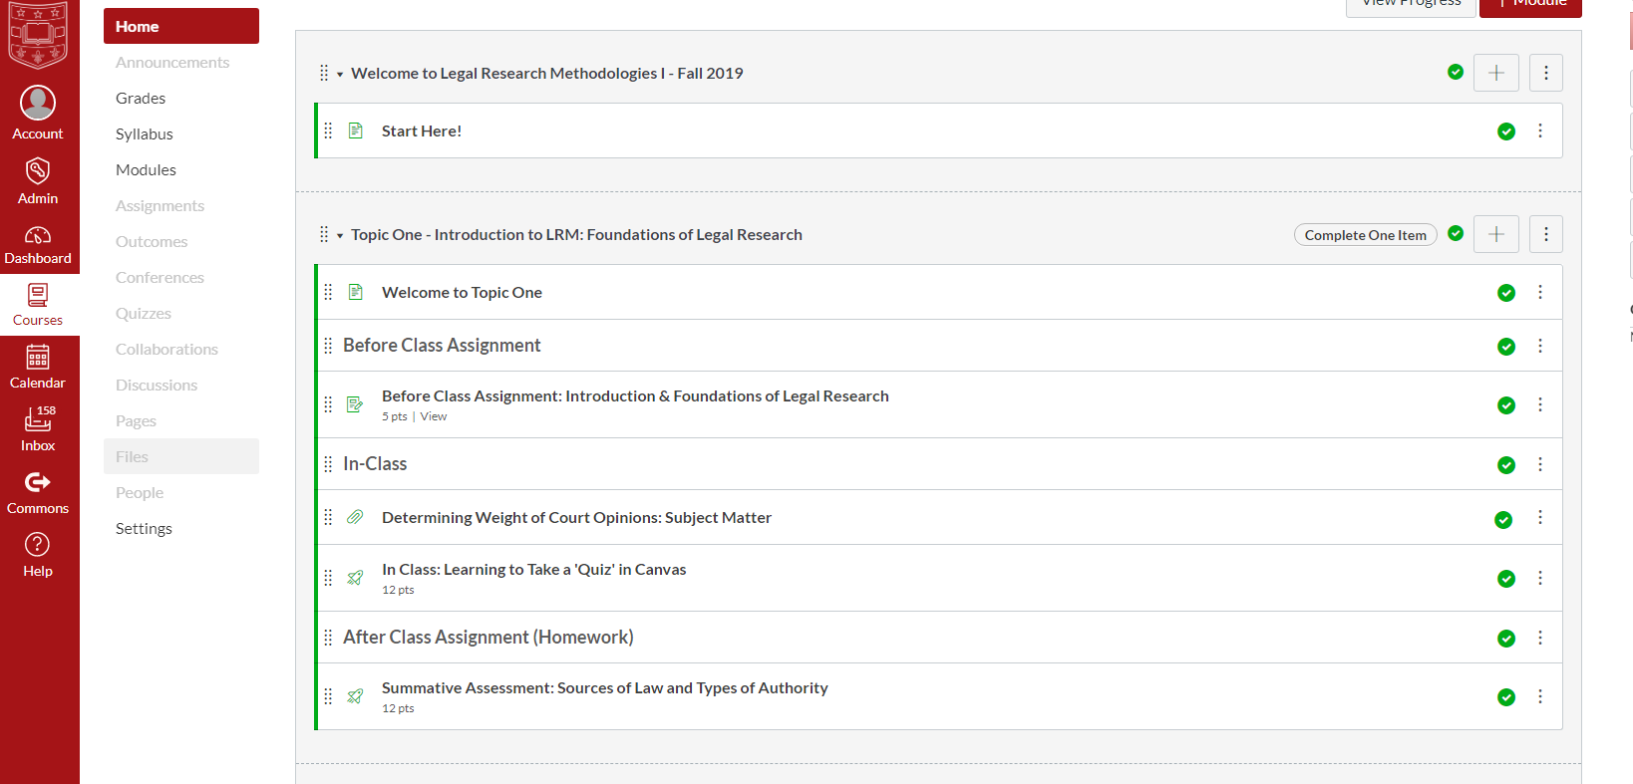
Course Structure
Canvas favors a Module-Based Approach
We decided to organize the Modules into Topics

Slide 14
Features Within Modules
Introductory Message to Orient Students to Transition between topics
Chronological Ordering of Materials
Before-Class
In-Class
After-Class
Final Summative Assessment
Conditional Release Ability
The after-class assignment must be uploaded before the Summative Assessment (final step) can be launched

Slide 15
Creation of Summative Assessments
Most challenging aspect
Even more-so than assignment creation
Differences of opinion need to be navigated
Objective grading was essential
To meet anonymity requirements of School
To reflect lack of resources for manual grading/feedback
Lessons
Students will challenge any ambiguous language/answers
Don’t be afraid to ‘cave’ when appropriate
Gauging appropriate level of difficulty very elusive
Always a work-in-progress

Slide 16
The ‘GradeBook’
Automatic and/or batch grading (for certain features)
Automatic deduction of points (by %) for late submissions
Flexible Grade Posting Policy
Includes Attendance Information
Facilitates Messaging based on Assignment or Assessment
Results Available to Students in their ‘view’
Extensive Student Analytics (Individual and Group-Based)

Slide 17
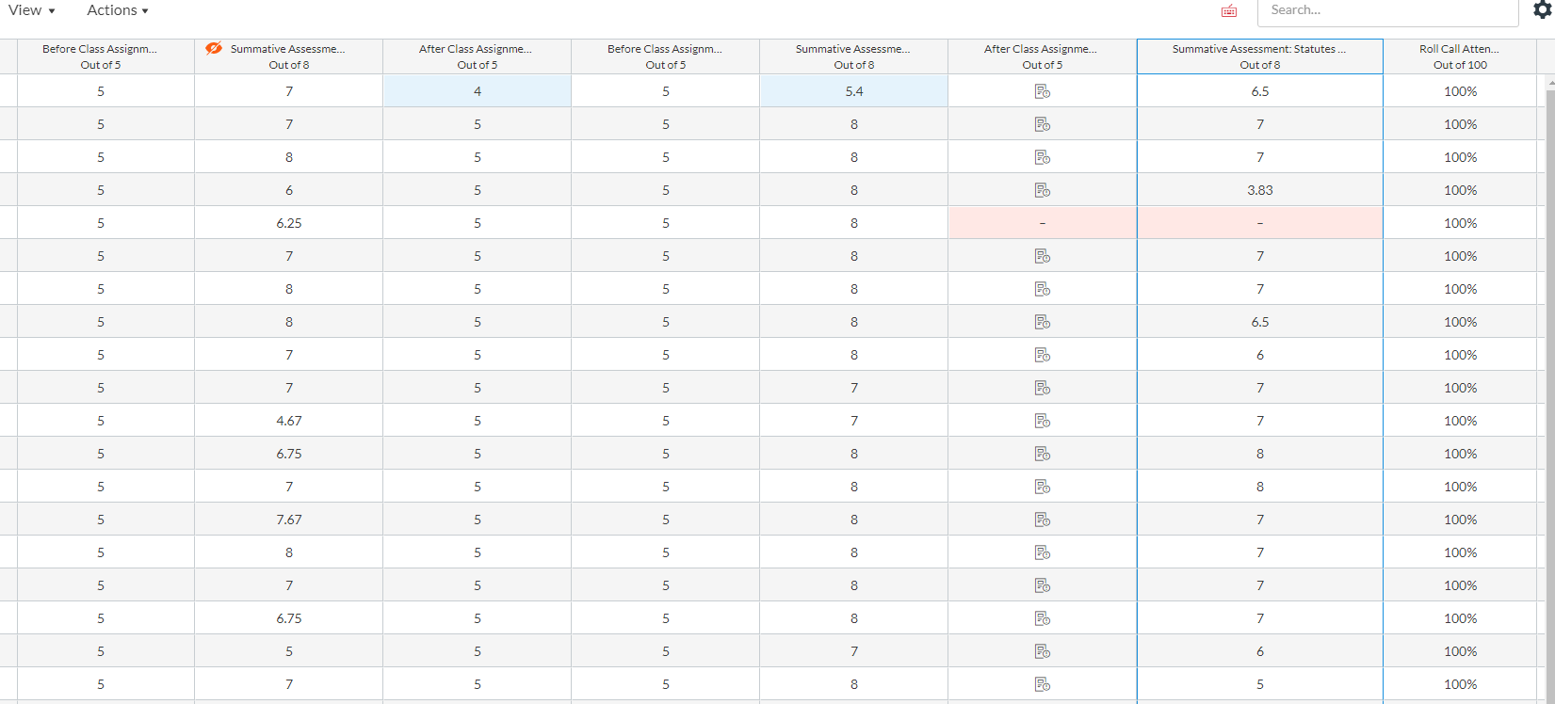
GradeBook Sample Screen

Slide 18
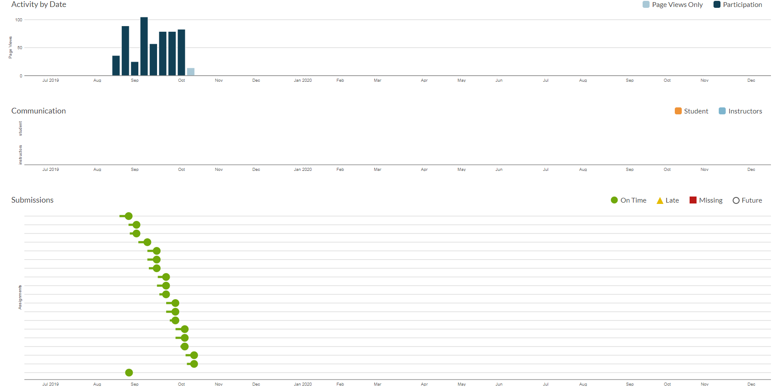
Student Analytics Screenshot

Slide 19
The Future
Canvas is upgrading Quiz feature (QuizzesNext)
This will provide additional options
Expanded use of Canvas (even beyond current level may be necessary if Quimbee is not used in future academic years
Third-Party add-ons for Canvas
Expanded learning tools
Voluminous options to be explored
Other supplemental platforms
Options need to be explored in late Spring and Summer
Reassessment at end of Spring 2020
Student Evaluations will be studied carefully

Slide 20
Questions?
Joyce McCray Pearson
jmccraypearson@wustl.edu
Dorie Bertram
bertram@wustl.edu
Hyla Bondareff
bondareh@wustl.edu
Aris Woodham
Woodham@wustl.edu

