Slide 1
Winning Strategies for Effectively Tracking and Using Data
MAALL Annual Meeting, Friday, Oct. 12, 2018
Rebecca Lutkenhaus, Drake University
Allen Moye & Denise Glynn, DePaul University
Rob Myers, Case Western Reserve University
Jennifer Prilliman, Oklahoma City University

Slide 2
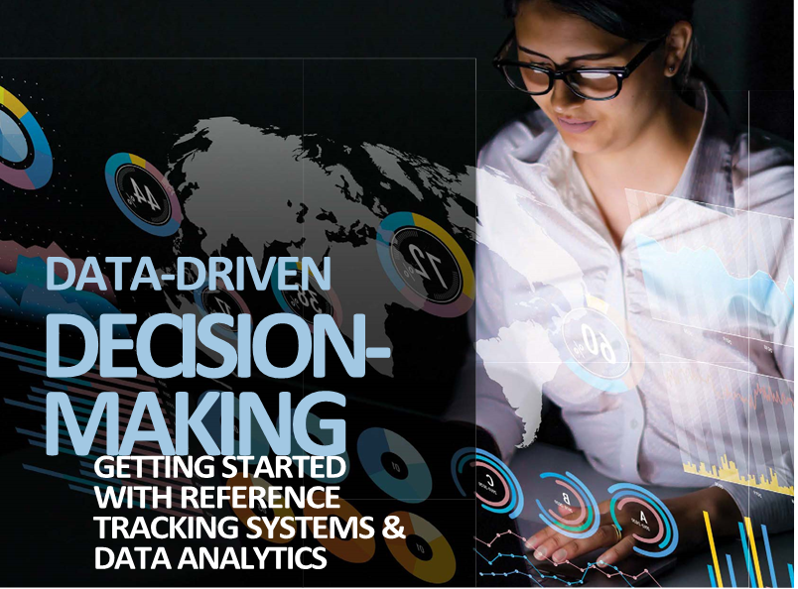
Amy Atchison & June H. Liebert, Data-Driven Decision-Making: Getting Started with Reference Tracking Systems & Data Analytics, AALL Spectrum, September/October 2018

Slide 3
Winning Strategies for Effectively Tracking and Using Data
Why Collect Data?
Five Core Components of Data Strategy
What Data Should a Law Library Collect?
Data-Driven Decision-Making
Using Data to Make Your Case
How Do You Collect Data?
Data Utilization in MALLCO
Questions

Slide 4
1. Why Collect Data?
Recognize, comprehend, and quantify strengths/weaknesses
Understand the changing demands on library resources
Justify focusing resources in a particular area
Motivate staff
Plan for growth and development

Slide 5
2. Five Core Components of Data Strategy
Identify - naming or value convention
Store - access & capacity
Provision - shared and reused
Process - understandable end product
Govern - rules or guidelines

Slide 6
3. What Data Should a Law Library Collect?
Data to inform purchases, policies, marketing, effectiveness, and efficiency
Circulation, guest visits, and database use
Data for external programs – admissions, career services, and advancement
Data for accrediting agencies and focus groups
ALLStAR

Slide 7
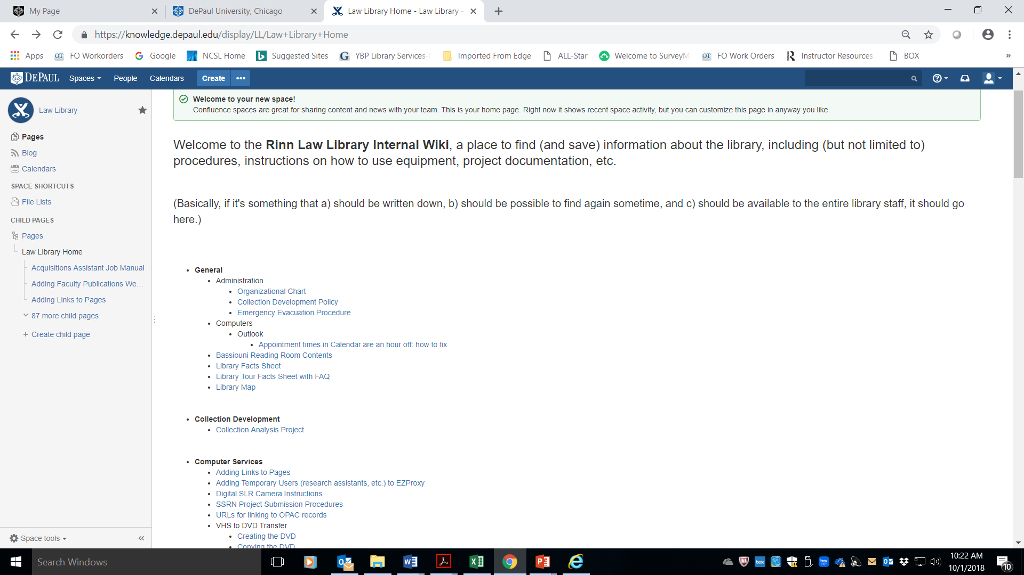
DePaul- Rinn Law Library ( Internal WIKI)

Slide 8
4. Data-Driven Decision-Making
Using data to inform:
Staffing decisions
Retention of electronic resources
Purchasing
Rebalancing the budget to better serve users

Slide 9
5. Using Data to Make Your Case
Challenges
Opportunities

Slide 10
DePaul Rinn Law Library- EBL Reports

Slide 11
6. How Do You Collect Data?
Questions to consider
Tools used to collect data at Case Western

Slide 12
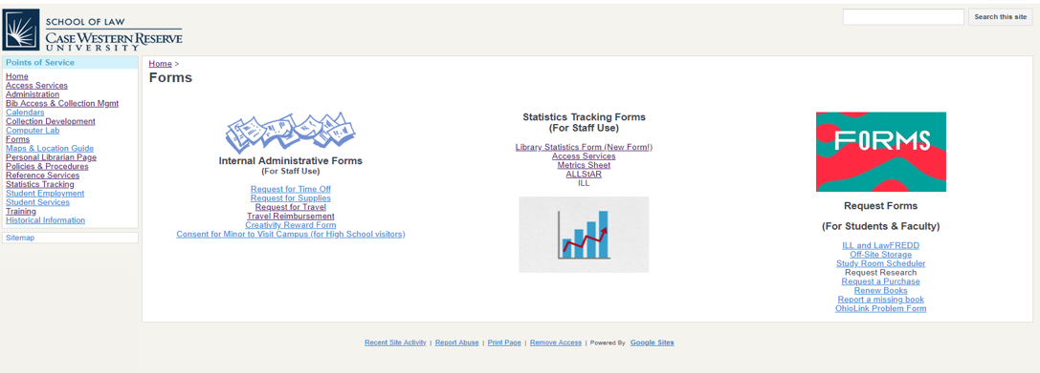
CWRU Law Library - Intranet Statistics Tracking Forms

Slide 13
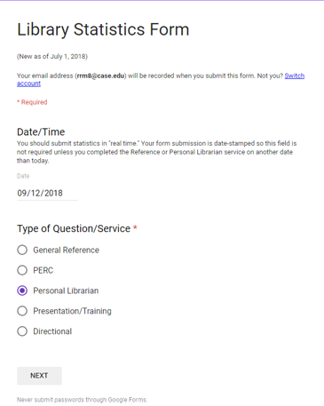
CWRU Law Library Reference Tracking Form (Using Skip Logic)

Slide 14
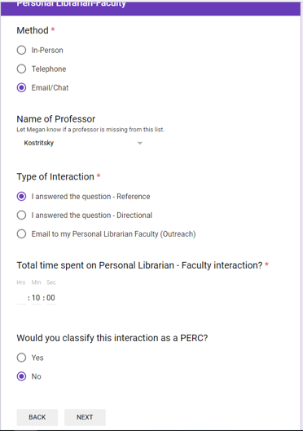
CWRU Law Library Reference Tracking Form

Slide 15
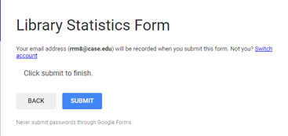
CWRU Law Library Reference Tracking Form

Slide 16
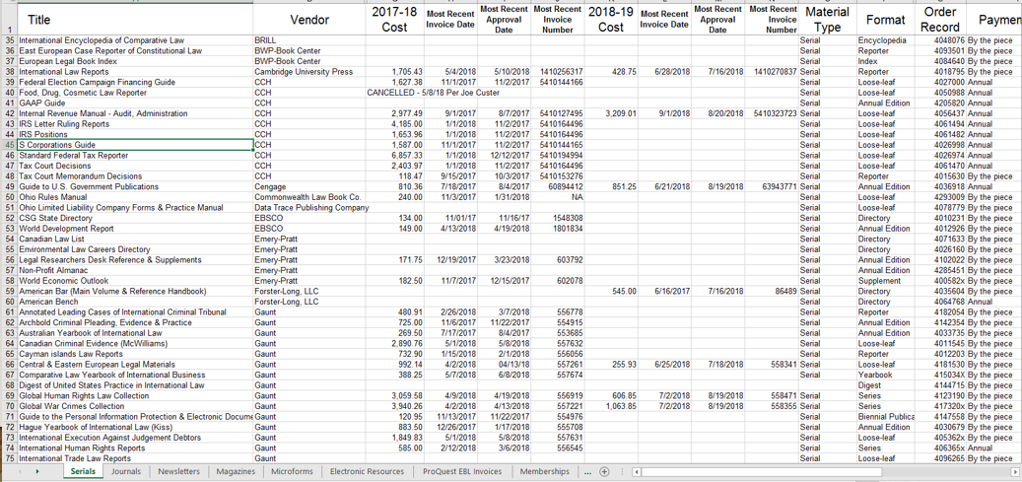
CWRU Law Library – Serial and Database Cost Spreadsheet

Slide 17
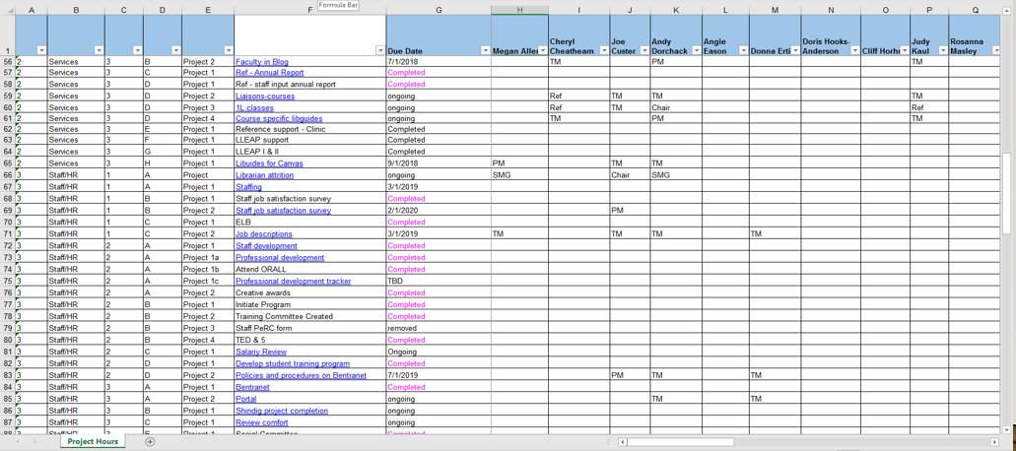
CWRU Law Library – Project Management Tracking

Slide 18
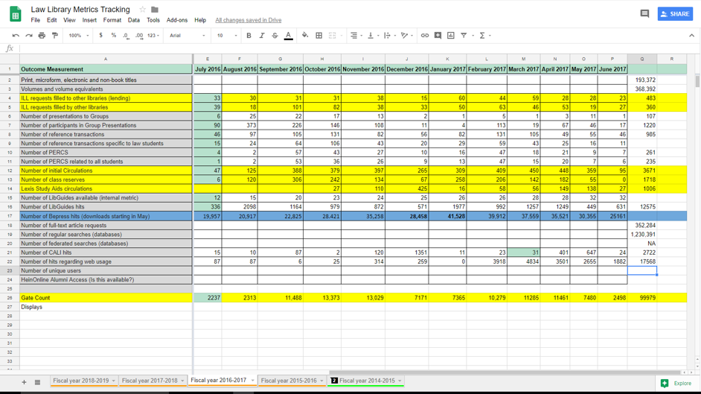
CWRU Law Library Metrics Tracking (For Deans)

Slide 19
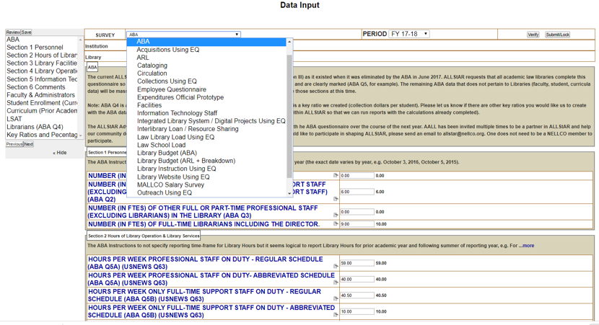
CWRU Law Library – Tier 4 ALLStAR Data Input

Slide 20
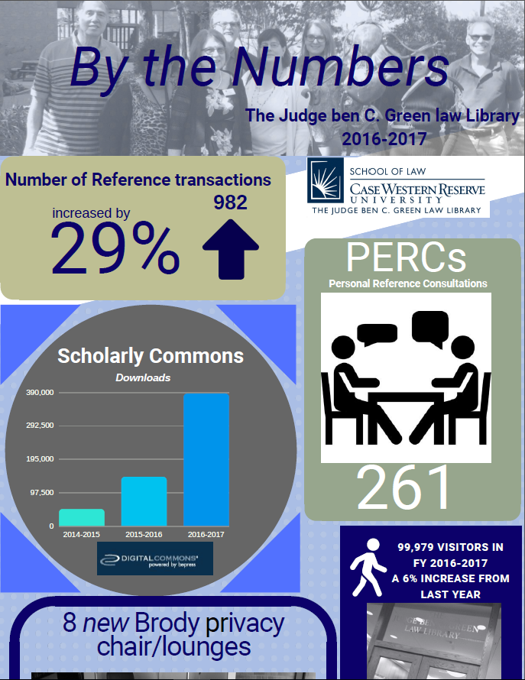
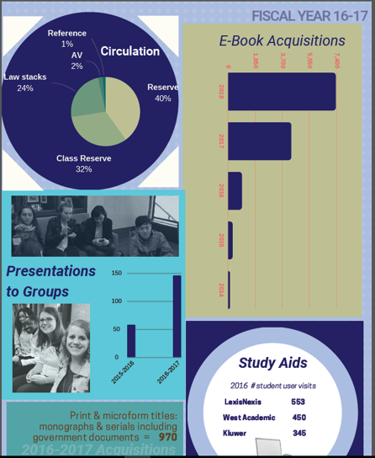
Statistics
used to
present a
graphical
Annual
Report

Slide 21
7. Data Utilization in MALLCO
Having comparative data helps to:
Identify our strengths
Focus on areas of collaboration
Reveal areas in need of improvement
Collection and Technology Survey, Model Survey
Statistics sharing with ALLStAR
Tools include:

Slide 22
Questions?
Winning Strategies for Effectively Tracking and Using Data
MAALL Annual Meeting, Friday, Oct. 12, 2018

