Slide 1
social media overhaul
KEEPING YOUR SOCIAL NETWORKING EFFORTS UP TO DATE
Cindy Bassett & Corie Dugas

Slide 2
HELLO!
IS THERE ANYBODY OUT THERE?

Slide 3
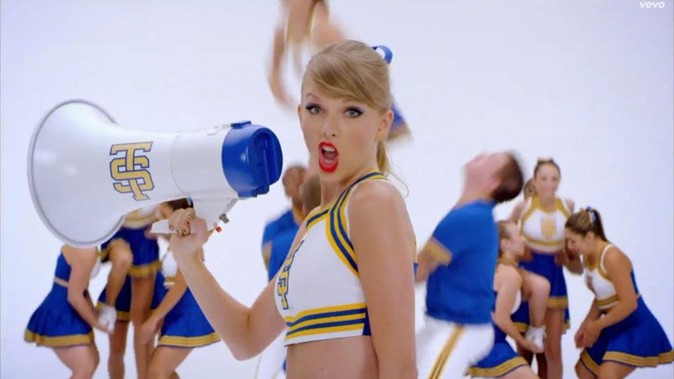
SHAKE IT OFF!

Slide 4
I don’t know where I’m going.
Only God knows where I’ve been.

Slide 5
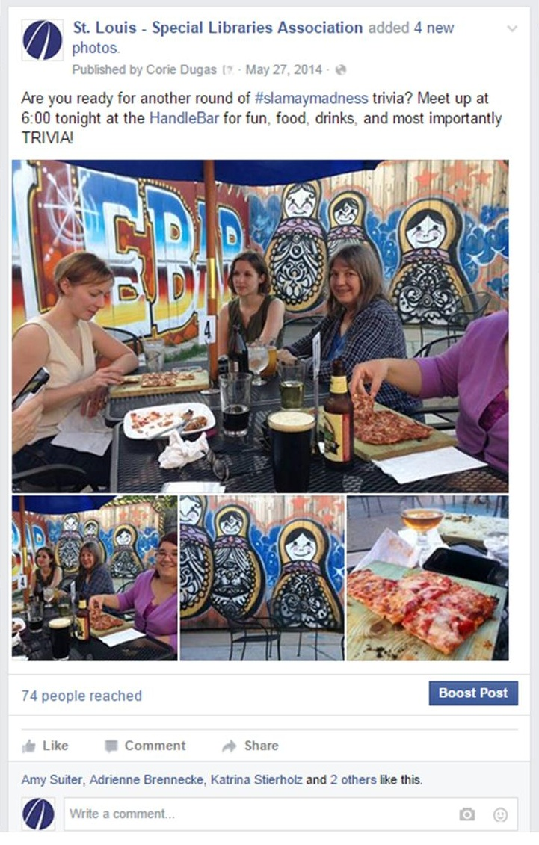
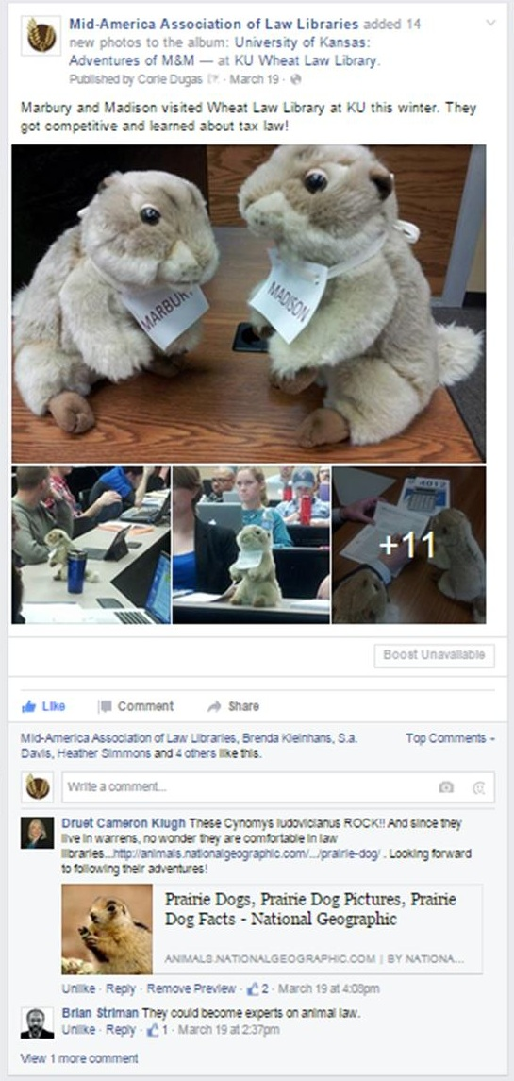
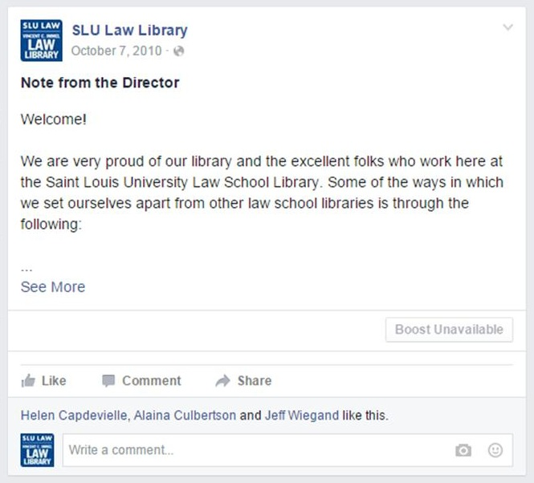
FIRST TRY

Slide 6
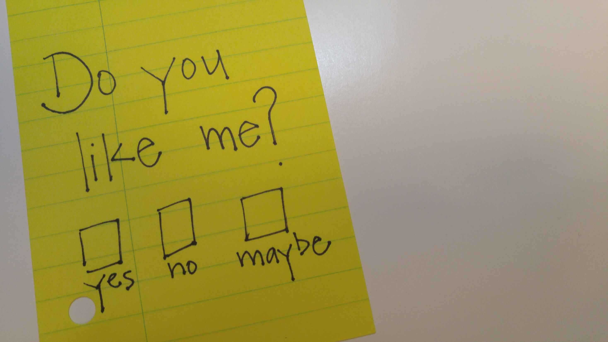

Slide 7
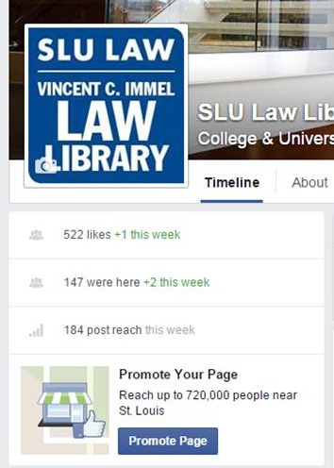
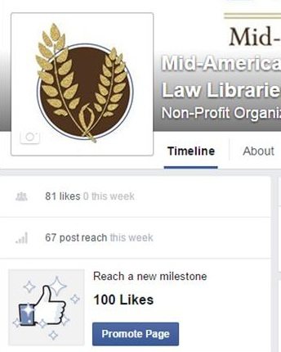
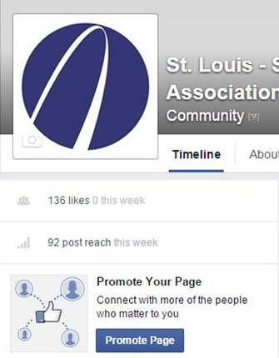
522
136
81
Notes:
NEEDING the likes. It makes us desperate.
Play up to your target market, and care less about likes.

Slide 8
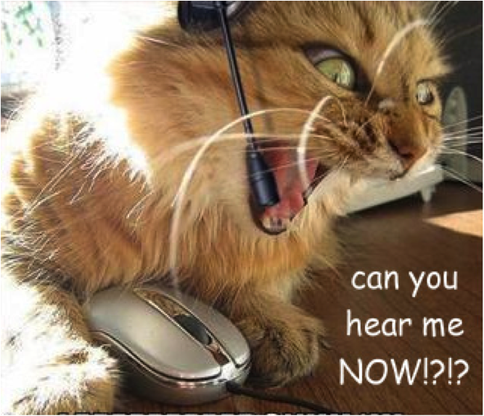

Slide 9
What works?
Funny
Pics of Peps
@ somebody
Quizzes

Slide 11
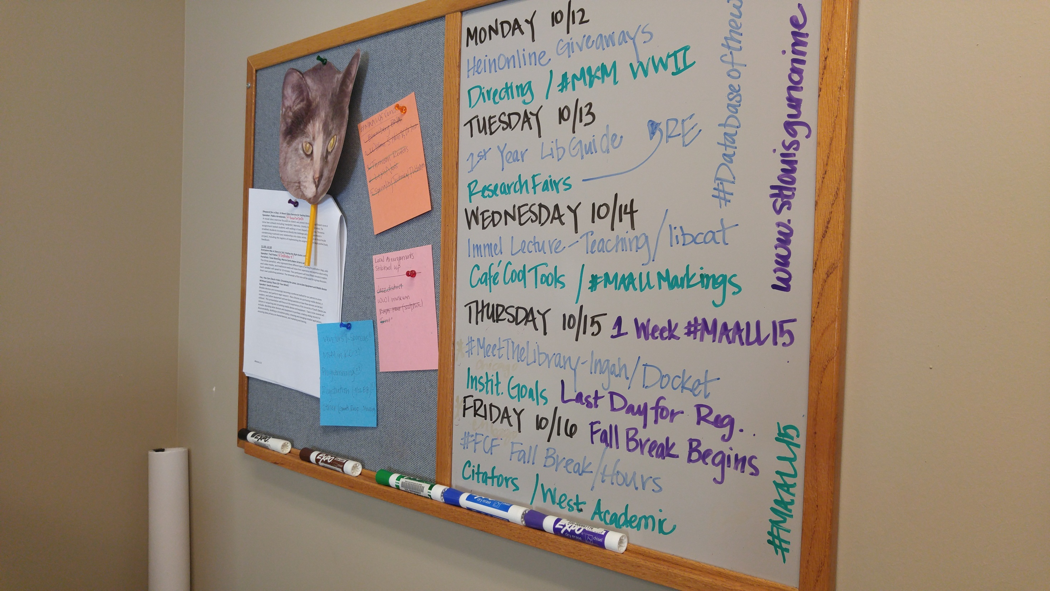
P
L
A
N

Slide 12
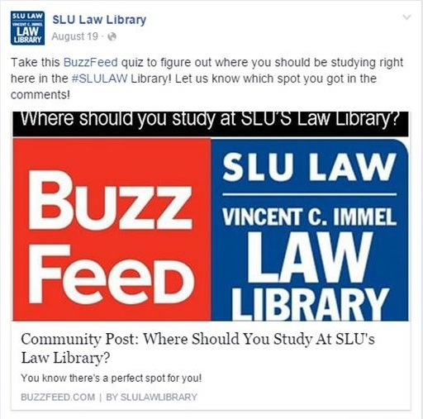

Slide 13
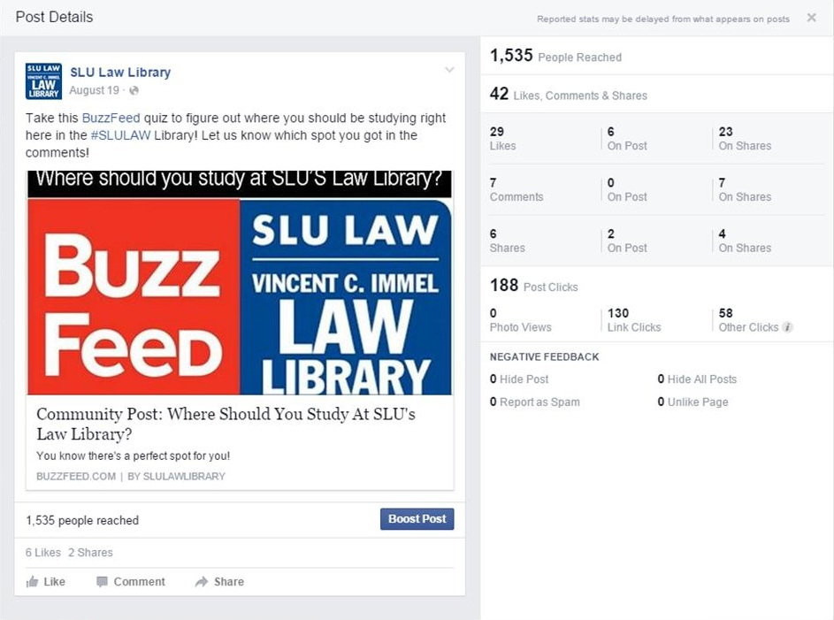

Slide 14
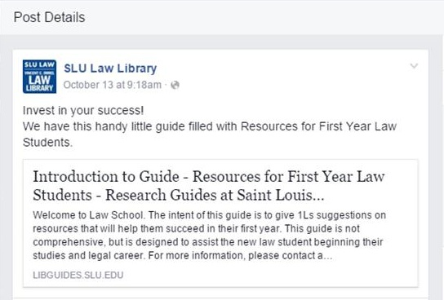

Slide 15
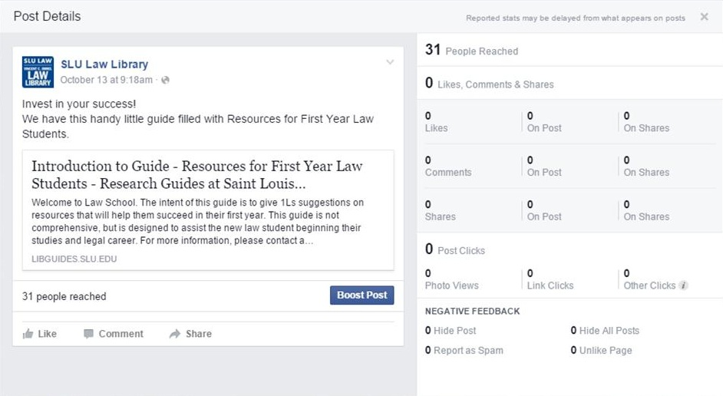

Slide 16
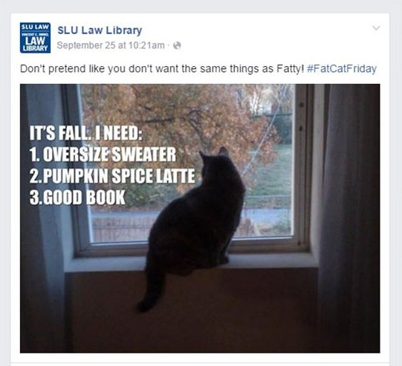

Slide 17
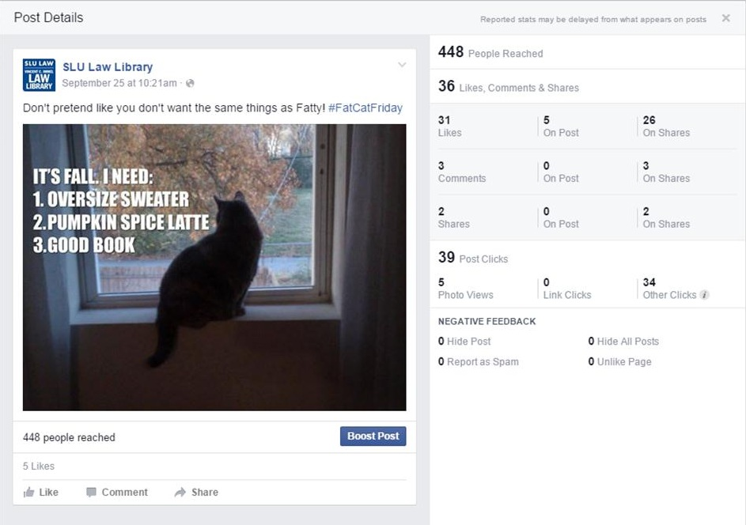

Slide 18
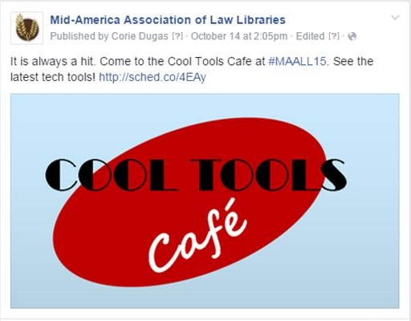

Slide 19
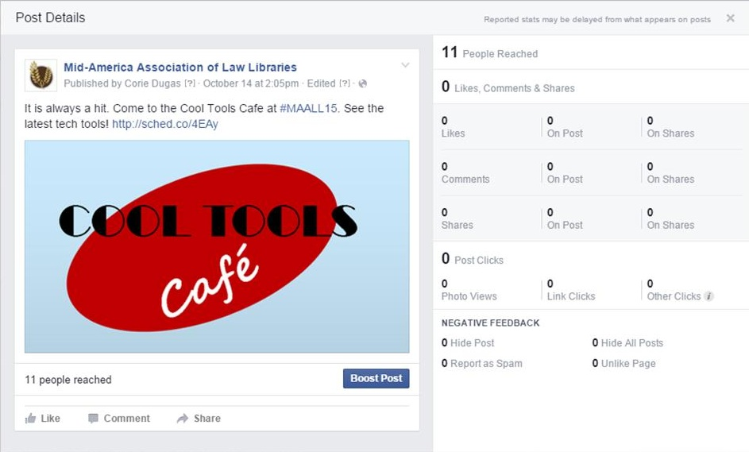

Slide 21
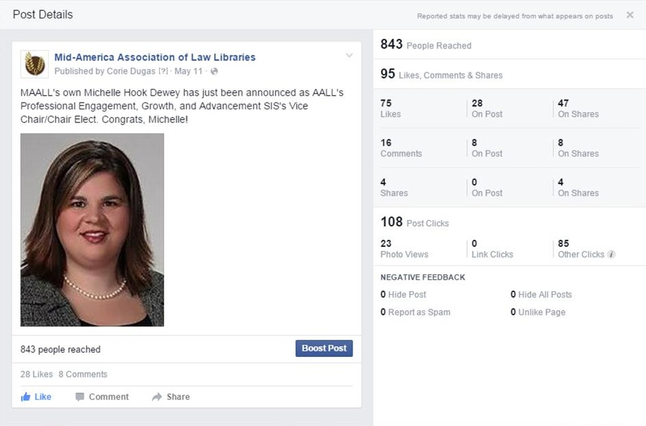

Slide 22
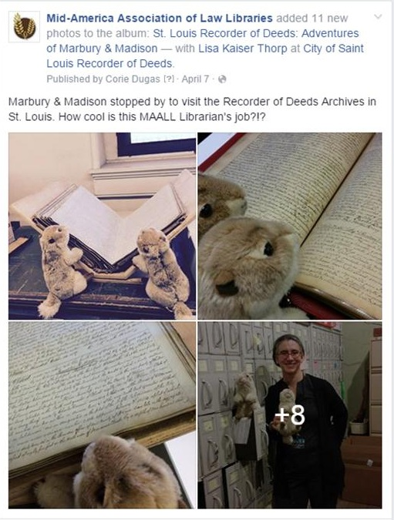

Slide 23
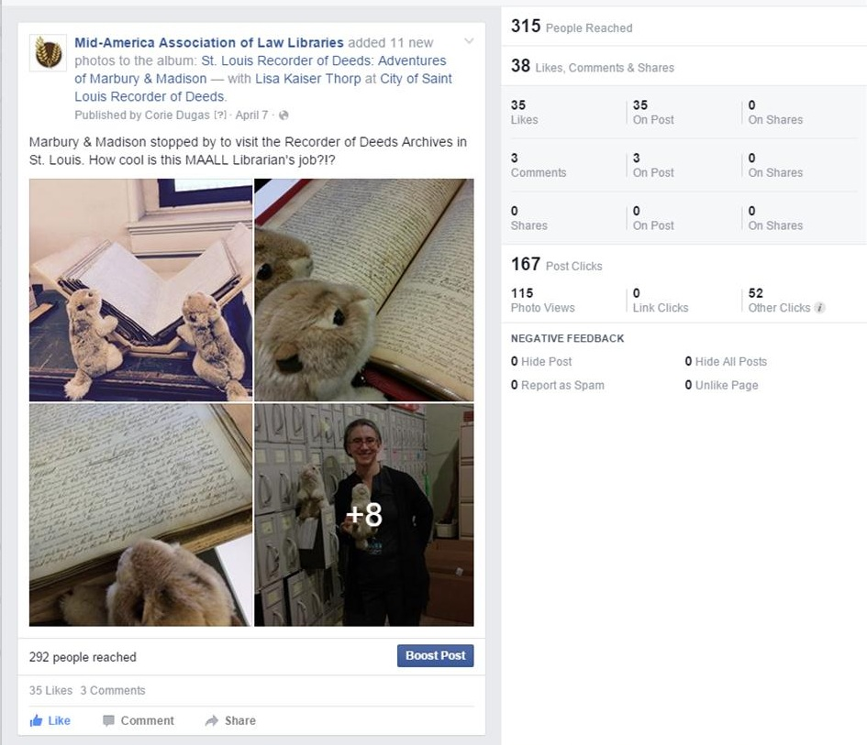

Slide 24
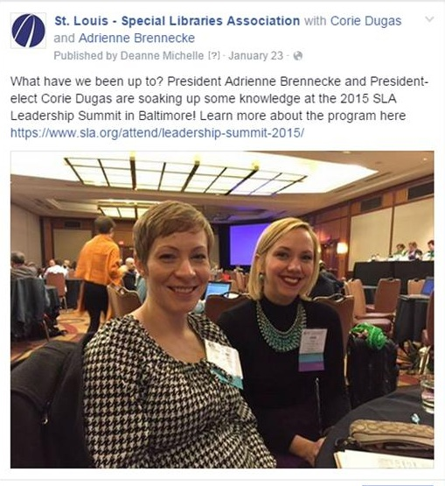

Slide 25
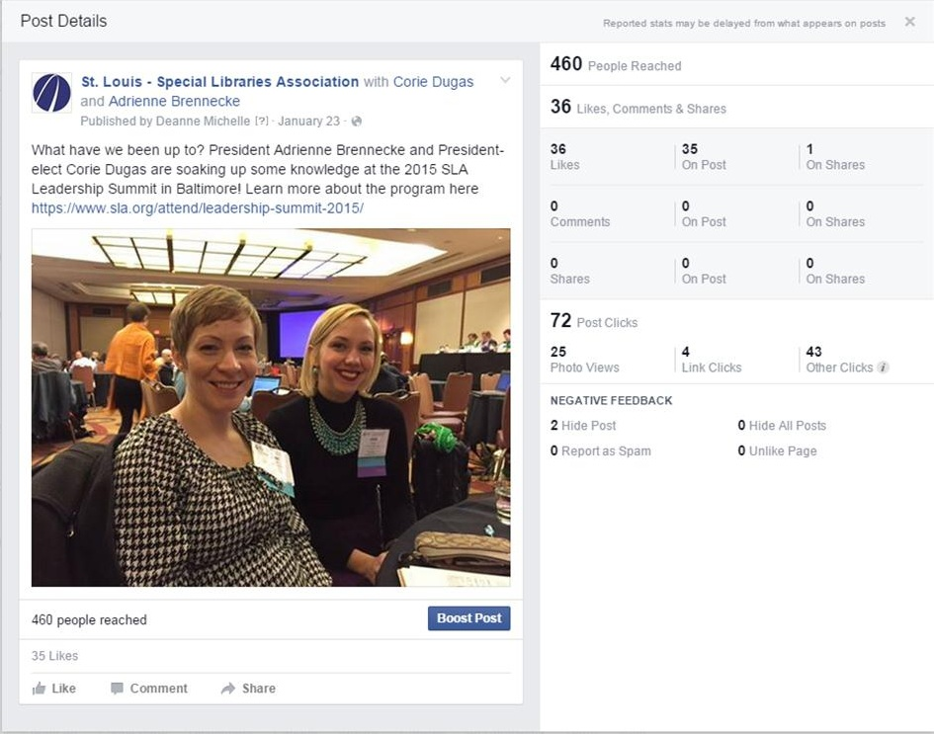

Slide 26
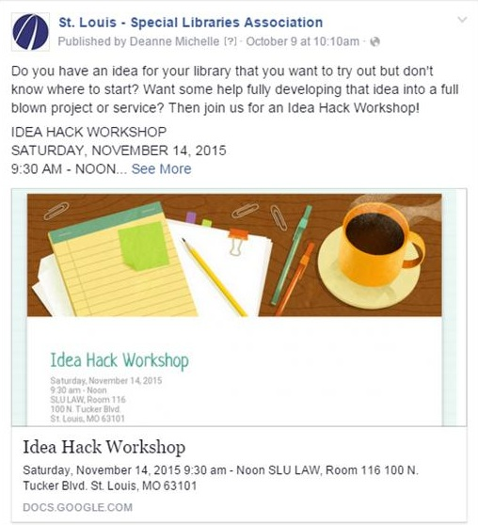

Slide 27
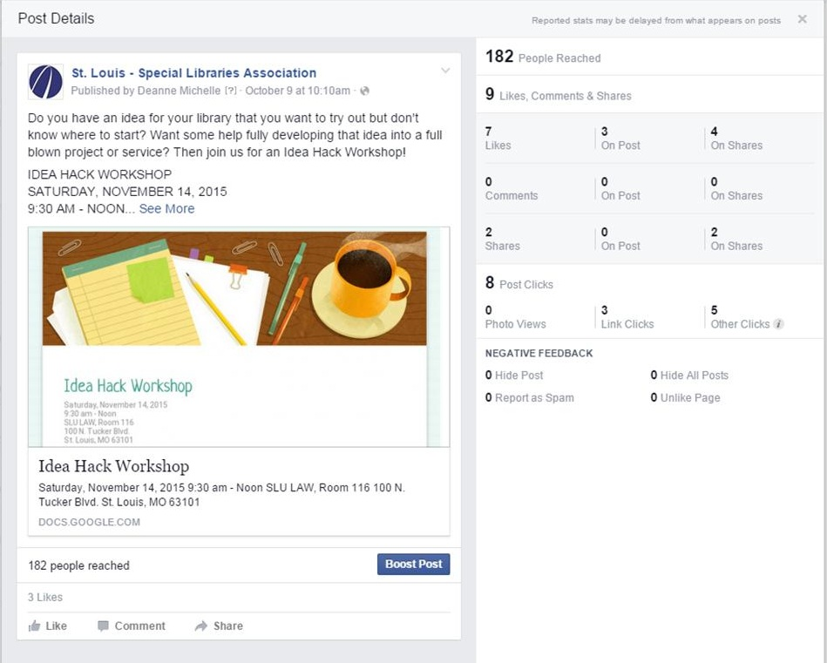

Slide 28
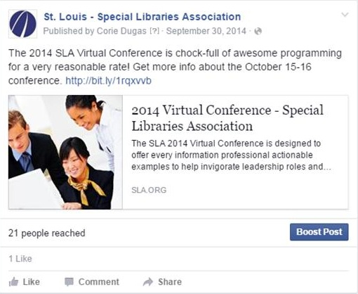

Slide 29
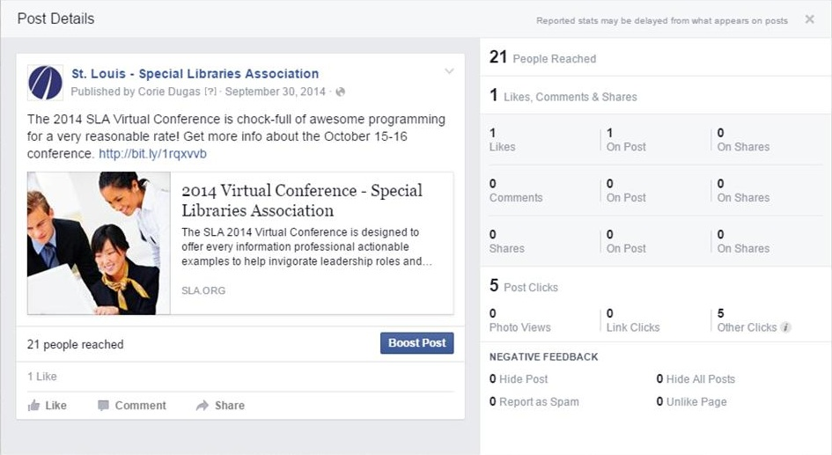

Slide 30
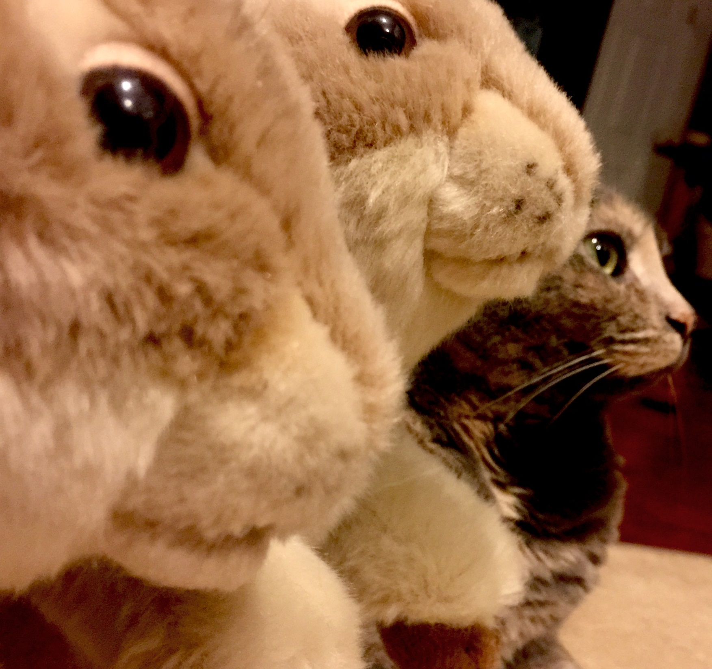
KEEP LOOKING AHEAD
#FatCatFriday #MarburyAndMadison

Slide 31
Social Networking Overhaul: Twitter

Slide 32
Social Networking Charge January, 2010
Social networking tools provide opportunities and responsibilities a modern academic law library must fully seize. This does not mean the library must use every tool at once or use them in the identical way other libraries are. The tools will change over time and rapidly, so we need a plan that will enable us to adapt our efforts to new social networking utilities that will in our careers supplement or supplant Twitter, Facebook and others in use today. Guiding these initiatives we need to establish our organizational social networking identity by determining how these tools can advance the library’s mission, implementing policies, procedures, and protocols to guide us in their proper use, and understanding our educational mission with regard to teaching students how to use these tools properly in legal study and law practice by example of how the library uses them and instruction.
Notes:
This is one paragraph of a 3 page document which explains why our director is NOT in charge of our Twitter account!

Slide 33
Time Sink
bogenfreund/556656621/
Notes:
So much time down the drain. I was following a lot of different libraries and people and trying to keep up with what everyone said. It proved to be impossible because it was too time consuming. Plus there was a lot that I didn't care about. Too much noise. But it was a learning experience. There is value in learning but it takes time.

Slide 34
Talking to Myself
tealeaves/379089984
Notes:
As Corie mentioned about Facebook, I too, felt like I was just shouting into the void. I wasn't sure who was listening. Were my students here? I did have an idea what my message should be but wasn't really sure of my voice.

Slide 35
Set a New Goal
g_kat26/3379203924
Notes:
Around 2012, I decided to change my approach to one of engagement. I set Goal #1 – I wanted to focus on engaging with our students and alumni using Twitter. I didn’t care about other libraries or the general public or our faculty or anyone else really, just those two groups. So, first I had to find them….

Slide 36
Finding My Peeps
azadam/129855494
Notes:
So, even though there were sites that tried to be a directory, I could find no true directory of twitter people. So, I started by searching twitter for Mizzou, MU, MU Law, Mizzou Law. As soon as I found someone who I could tell was a student or alum, I followed them. Then I searched their followers and who they followed to see if I could identify other students/alums. I kept the global address book humming I was searching so many people.

Slide 37
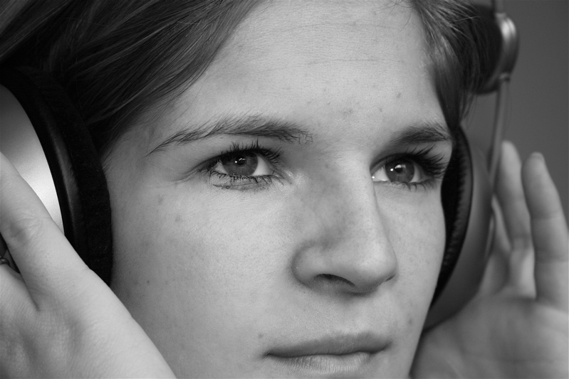
A little less talk, a lot more listen
jonaschansen/476908525/
Notes:
I started to listen to students and alumni and also to tweet consistently with the hashtag #MizzouLaw so I could catch the attention of those who cared, hopefully signal to them to use the same hashtag, and to be able set up a saved search for those tweets. Still too much signal to noise ratio amongst all the others I was following.

Slide 38
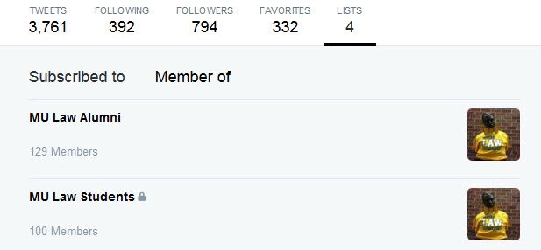
Lists, Lists, Lists
familyartstudio5614643257
Notes:
By that time, Twitter lists were possible and I added those I found to one of two lists - Alumni which was public and students which was a private list due to FERPA concerns.

Slide 39
Hello, Hootsuite!
Notes:
Hootsuite let me view my lists all in one place. It let me load my social media into one place, though to be honest, I don’t like looking Facebook in it. I do post to Facebook from it.

Slide 40
Talk Amongst Yourselves…
Sadly blatant thievery w/ apologies to http://blog.krrb.com/
Notes:
Once I could distill their voices, I got to know my students and alumni better. Sometimes, too much better, if you know what I mean.

Slide 41
Adjustments
oldonliner/7036781245
Notes:
I did a year long experiment in which I sent follow requests to ALL our students. Some accepted without question, some denied, some said, “Who is this?” Overall, after I did it, I realized that I didn’t WANT to hear anything students thought they were saying privately. I discontinued. Now I add all accounts that I can find the list and only follow public accounts.

Slide 42
Listen > Inform > Love… (and be a little funny)
My goal now…

Slide 43
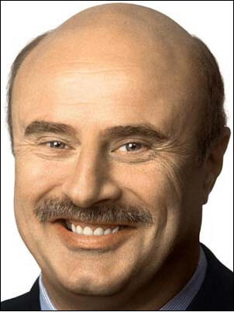
How’s that working out for you?
greggoconnell56487830
Notes:
Pretty well, I think!

Slide 44
Alumni interaction – Listen*
“Anyone know of a good podcast?”
* Note: Tony_Be also likes R&B and rap, lives in major MO city, and has an adorable toddler. How do I know this? 81K tweets

Slide 45
Alumni interaction – Inform

Slide 46
Alumni interaction – and love

Slide 47
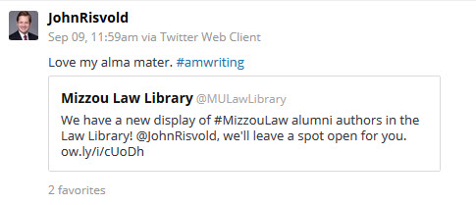
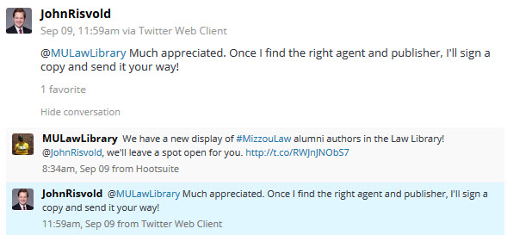
Alumni interaction Listen > Inform > Love

Slide 48
Alumni interaction – and add a little personality

Slide 49
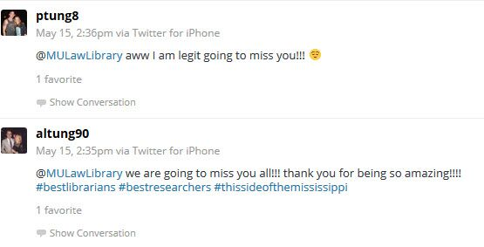
Alumni interaction – we get love, too!

Slide 50
Students - Listen

Slide 51
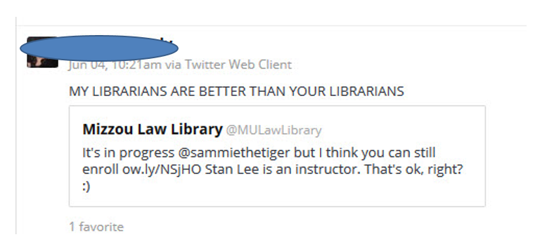
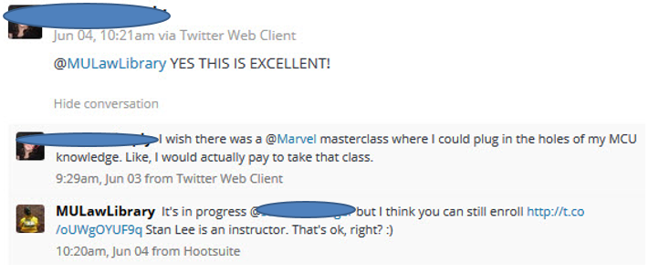
Student – Listen > Inform > Love

Slide 52
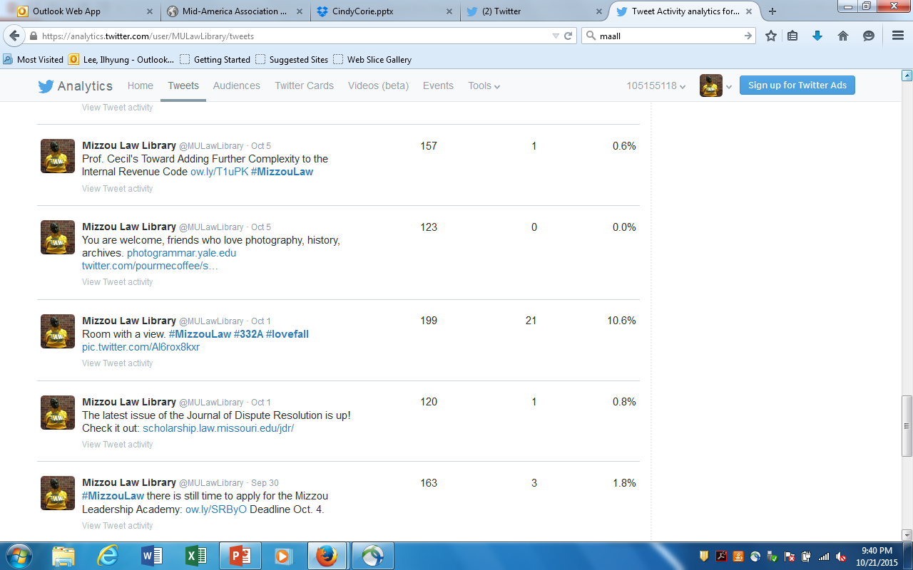
Notes:
Pictures work.

Slide 53
Contact Us
Cindy Bassett
Electronic Services Librarian
University of Missouri Law School Library
573-884-9150
bassettcw@missouri.edu
https://twitter.com/MULawLibrary
Corie Dugas
Outreach and Public Services Librarian
Saint Louis University Law Library
314-977-3449
cdugas@slu.edu
https://www.facebook.com/SLU-Law-Library-128831620502018/

