Slide 1
NextGen Bar Exam: Surveying the Landscape and Preparing the Future

Slide 2
Content Scope Outlines
May 2023, NCBE released the Content Scope Outlines for the NextGen bar exam, which is set to launch in 2026.
The content scope document outlines the breadth of material to be covered on the new exam.
Eight areas of legal knowledge and seven categories of practical skills and abilities
Source: From My Perspective: Essays on the NextGen Bar Exam and Legal Education,
The Bar Examiner, Summer 2023 (Vol. 92, No. 2).
Authors: Dennis C. Prieto, Susan Landrum, Timothy J. McFarlin, and Wanda M. Temm

Slide 3
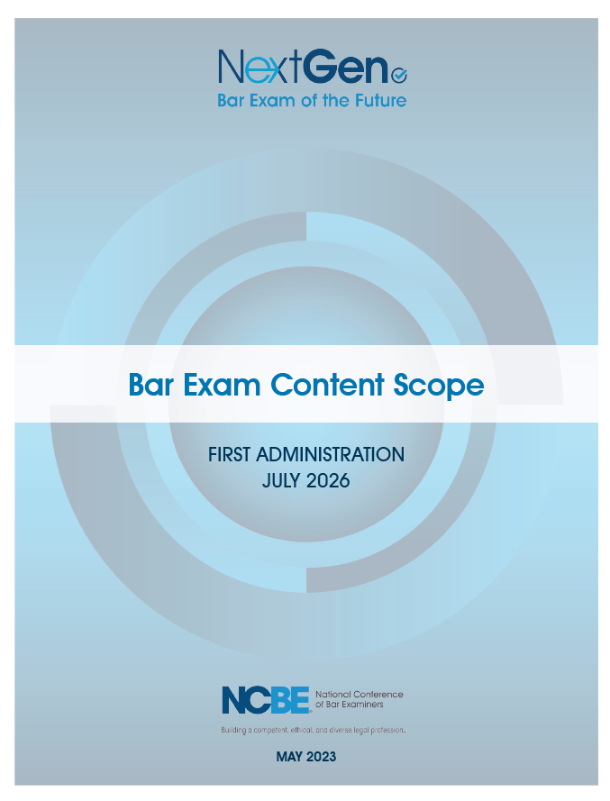

Slide 4
NCBE appointed a Content Scope Committee (CSC)
Make recommendations on the breadth and depth of the:
Foundational Concepts and Principles
Foundational Skills

Slide 5
Breadth of topics in each subject
Frequency: How often is a newly licensed lawyer (defined as one who has practiced for fewer than three years) likely to encounter the topic in general entry-level practice (loosely defined as solo practice or working at a full-service law firm)?
Universality: How likely is a newly licensed lawyer to encounter the topic in more specialized types of entry-level practice?
Risk: How likely is it that there will be serious consequences if a newly licensed lawyer does NOT have any knowledge of the topic when it arises?

Slide 6
Depth
CSC focused on how much detail a newly licensed lawyer should recall about each topic , without research, to provide minimally competent legal services

Slide 7
Depth
Complexity: How complex or nuanced is the legal doctrine in this topic?
Context: How quickly must a lawyer act when this topic arises (i.e., would a newly licensed lawyer typically have time to conduct research before providing counsel)?
Stability/Universality: Is the doctrine relatively stable or in flux? Is there a clear majority approach among the states (or circuits)? (These questions sometimes overlapped in the Content Scope Committee’s discussions.)

Slide 8
The Content Scope Outlines are just the first step in preparing the Test Content Specifications
TCS – the “blueprint” for the new exam
Will be published in late 2024

Slide 9
Test Content Specifications
Provide more details, such as the sources of law for the topics being tested
The weighing or emphasis of the subjects/topics/skills
Sample test questions illustrating how the knowledge and skills may be tested in an integrated design
Additional annotations about what is covered within the subject/topics may also be added

Slide 10
May be different
The organization and the structure of the Test Content Specifications may be different than the organization and structure of the Content Scope Outlines

Slide 11
Levels of research
What level of research skills should a newly minted lawyer have?
What level of research skills should a practicing lawyer have?
Venn diagram??????

Slide 12
How will platform dominance impact the NextGen Bar?
because the study of research is itself the study of how our approach to gathering knowledge changes depending on how, and with what tools, we pursue it. As technology continues to inform research platforms, the time we spend studying research is time spent studying how we understand the world we live in, and how we can observe it changing before our eyes.
- NextGen Unites Skills with Doctrine for Today’s Legal Profession
- Dennis C. Prieto

Slide 13
Wanda Temm: Served on the Testing Design Task Force
From what I have seen so far:
the legal research questions seem to be very broad and more about planning research and decisions between sources to research than about constructing searches.

Slide 15
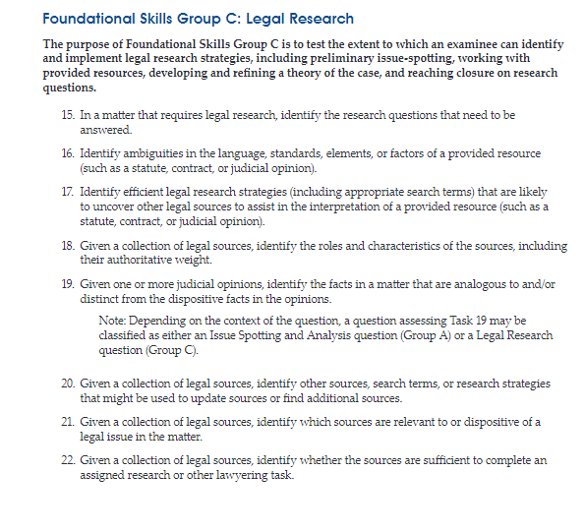

Slide 16
Legal Research Questions Question 15
In a client matter that requires legal research, identify an accurate way to frame the research questions that need to be answered.

Slide 17
Legal Research Questions Question 16
In a client matter that requires interpretation of a provided legal source (or excerpt) such as a statute, rule, constitutional provision, contract, or judicial opinion, identify which words or elements in the provided source seem legally significant and/or potentially ambiguous.

Slide 18
Legal Research Questions Question 17
In a client matter that requires interpretation of a provided legal source (or excerpt) such as a statute, rule, constitutional provision, contract, or judicial opinion, identify efficient research strategies (including appropriate search terms) that are likely to uncover other legal sources to assist in this interpretation.

Slide 19
Legal Research Questions Question 18
Given a collection of legal sources (or excerpts) that may be relevant to a client matter, identify the roles and differing characteristics of the sources, including their authoritative weight.

Slide 20
Legal Research Questions Question 19
Given one or more judicial opinions (or excerpts) that may be relevant to a client matter, identify the dispositive facts from the opinions, as well as the facts in the client’s matter that are analogous to and/or distinct from the dispositive facts in the opinions.

Slide 21
Legal Research Questions Question 20
Given a collection of legal sources (or excerpts), identify other sources, search terms, and/or research strategies that might be used to update sources or find additional sources.

Slide 22
Legal Research Questions Question 21
Given a collection of legal sources (or excerpts) that may be relevant to a client matter, identify which sources are relevant to or dispositive of a legal issue in the matter.

Slide 23
Legal Research Questions Question 22
Given a collection of legal sources (or excerpts) that may be relevant to a client matter, identify whether the sources are sufficient to complete an assigned research or other lawyering task.

