Slide 1
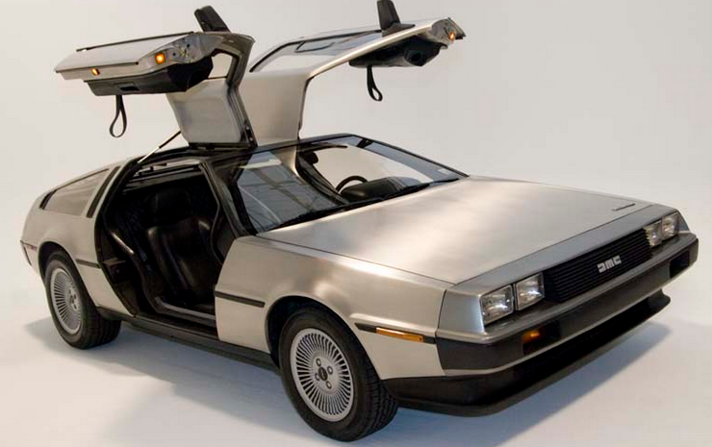
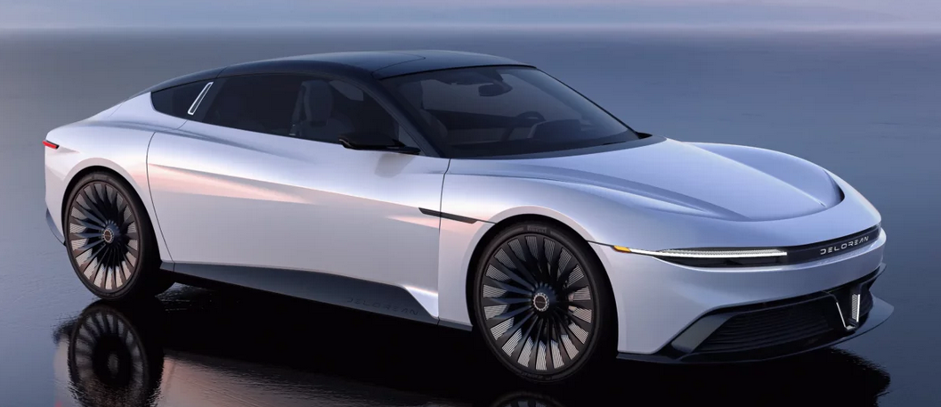
Building a Better DeLorean: Being Prepared for What the Future Brings
DeLorean DMC-12 *
2023 DeLorean Alpha5 https://delorean.com/
*DeLorean DMC-12 with doors open.jpg Kevin Abato www.grenexmedia.com
CC BY-SA 3.0

Slide 2
Presenters
Joseph Custer
Law Library Director
Case Western Reserve Law School
John Edwards
Associate Dean for Information Resources and Technology
Drake University Law School
Richard Leiter
Law Library Director
University of Nebraska College of Law
Carissa Vogel
Law Library Director
University of Iowa College of Law

Slide 3
A Few of the Challenges – John Edwards
Enrollment cliff
Fewer students choosing to go to college
Attacks on higher education
Culture wars
Court and legislative impacts
Perception of everything being online
Coveting of library space
Impact of Generative AI
NextGen Bar
Budget
Recruiting law librarians
Rankings
Skills of entering students (COVID impact, mental health, etc.)
Lack of student experience in a library or engagement with librarians
Saturday, October 14, 2023
Building a Better DeLorean: Being Prepared for What the Future Brings

Slide 4
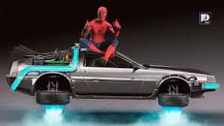
Strategy Development from Carissa Vogel
Be the spider
Understand the web
Spin the web
Crawl the web
Saturday, October 14, 2023
Building a Better DeLorean: Being Prepared for What the Future Brings

Slide 5
Strategic Insights from Joe Custer
How will the enrollment cliff for Universities and Colleges impact Law Schools and Libraries?
I. What is the enrollment cliff? Are there signs it is already here?
II. What can Law Schools do to avoid going over the cliff?
III. What strategies can Law Libraries consider to prepare for the cliff and
upcoming challenges in terms of:
Space
Service
Collections
Saturday, October 14, 2023
Building a Better DeLorean: Being Prepared for What the Future Brings

Slide 6
Policy Planning from Rich Leiter
Adapting to Change – Don’t throw out the baby with the bathwater.
Applying S.R. Ranganathan’s Five Laws of Library Science
Books are for use
Every person, his or her book
Every book its reader
Save the time of the reader
A library is a growing organism
Saturday, October 14, 2023
Building a Better DeLorean: Being Prepared for What the Future Brings

Slide 7
Questions?
Saturday, October 14, 2023
Building a Better DeLorean: Being Prepared for What the Future Brings

