Slide 1
4B: Law Library Marketing and Advocacy
Securing the Future by Writing our Own Stories

Slide 2
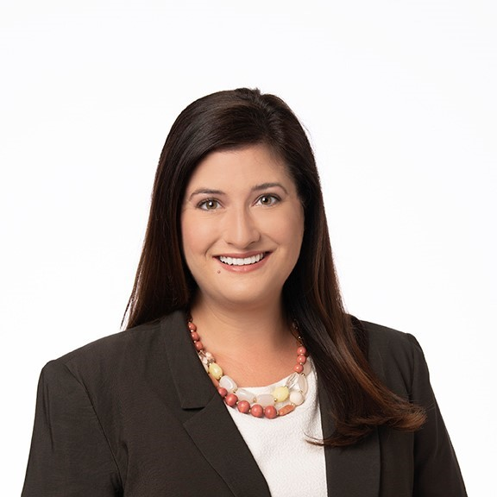
Allison C. Reeve Davis
Matthew E. Braun
Sr. Manager – Knowledge & Research Services
Littler Mendelson
Director of the Law Library
Saint Louis University School of Law

Slide 3
Why market and advocate?

Slide 4
Why market and advocate?
Challenges
Attrition, smaller qualified candidate pools
Restricted budgets, diminished standing within institution
Physical space constraints
Fears of economic recession
Benefits
Individuals (growth / career development, aspirations)
Departments / Teams (especially for non-revenue-generating)
Institution (libraries at the table, contributing)
Profession (libraries have wide expertise, importance)

Slide 5
Ready, Set, Go: Principles of Law Library Marketing
(Targeted)

Slide 6
Ready, Set, Go: Principles of Law Library Marketing
Measure
and
follow up
Set goal
Target your audience
Set a cadence
Consider all outlets
Seize opportunities
Got swag?
Find partners
Stick to a timeline

Slide 7
Can’t Stop, Won’t Stop: Principles of Law Library Advocacy
(Broad)

Slide 8
Can’t Stop, Won’t Stop: Principles of Law Library Advocacy
Championing yourself, team, department, institution, profession
Using your data
Carefully planned and deployed
Requires thoughtful cataloging
Needs
Gratitude
Successes
Failures
Market trends
Institutional goals
Tools and Technology
Resource and usage tracking
Data visualization: Power BI
Request tracking – categorization, complexity, requesters
At firm we also use time entries
All of these can help you identify opportunities – needed tech, resources, hours, space

Slide 9
Marketing: Frontline Stories

Slide 10
Marketing: Frontline Stories
Midwest Research Expo – MAALL academic law libraries
External interaction / Community engagement – bringing the law library to the law school
Billable research and services
Casetext – Gamification
Examples from all of you

Slide 11
Advocacy:
Wins and Lessons Learned

Slide 12
Advocacy: Wins and Lessons Learned
Department and title changes (+ promotion, retention)
Participation in data, training, resource acquisition initiatives
Women’s Leadership Initiative
Partnerships (with influential entities outside the law library)
Resource allocation
Examples from all of you

Slide 13
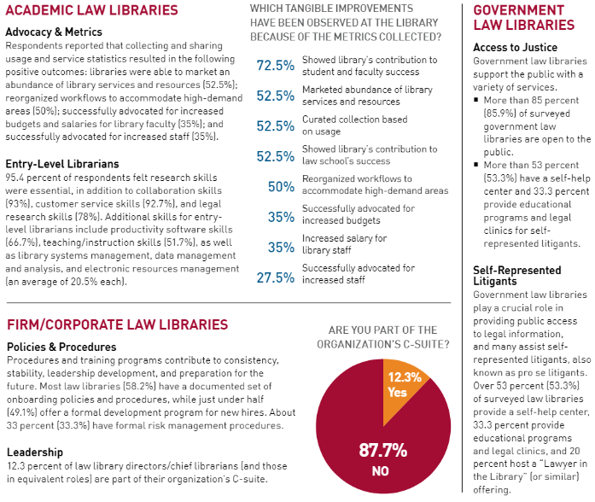
Highlights from AALL State of the Profession 2023
Advocacy wins for Academic Law Libraries
Law firm librarians take a seat at the table of influence
The crucial role of government law librarians in society
AALL Spectrum, July/August 2023, page 8

Slide 14
Discussion
Reaction
Concluding Remarks

Slide 15
Suggested Reading
AALL Spectrum, Marketing Your Value issue, September-October 2023
American Association of Law Libraries, Academic Law Library Marketing & Outreach Toolkit
Cynthia Brown, Ana Ramirez Toft-Nielsen, and Allison C. Reeve Davis, Future of Law Firm Librarianship, in Introduction to Law Librarianship (2021)
Ursula Gorham and Paul T. Jaeger, The Law School Library or the Library at the Law School?, 109 Law Library Journal 51 (2017)

Slide 16
Suggested Reading
Kenneth J. Hirsh, Like Mark Twain: The Death of Academic Law Libraries in an Exaggeration, 106 Law Library Journal 521 (2014)
ALL-SIS Task Force on Library Marketing and Outreach, Marketing and Outreach in Law Libraries: A White Paper, 105 Law Library Journal 525 (2013)
Beatrice A. Tice, The Academic Law Library in the 21st Century: Still the Heart of the Law School, 1 UC Irvine Law Review 157 (2011)
Taylor Fitchett, et al., Law Library Budgets in Hard Times, 103 Law Library Journal 91 (2011)

Slide 18
Allison C. Reeve Davis
Matthew E. braun
Sr. Manager – Knowledge & Research Services
Littler Mendelson
Director of the Law Library
Saint Louis University School of Law

