Slide 1
Professional Reading
Without the Reading!
Resa Kerns
Univ. of Missouri School of Law

Slide 2
The Book
The ONE Thing: The surprisingly simple truth behind extraordinary results
Gary Keller: author, teacher, and real estate entrepreneur. Co-founder of Keller Williams Realty

Slide 3
The Idea
If you chase two rabbits,
You will not catch either one

Slide 4
The Lies
They mislead and derail us

Slide 5
I just have too many things that MUST be done!
Equality (of to-do’s) is a lie.

Slide 6
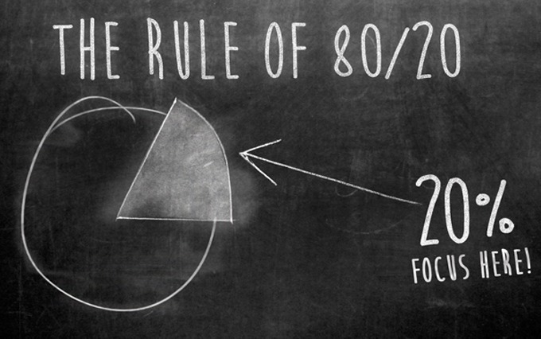
Pareto’s Principle Law of the Vital Few

Slide 7
Truth
Things don’t matter equally, and success is found in doing what matters most.

Slide 8
I’ll get more done by doing things at the same time!
Multitasking
is a lie.

Slide 9
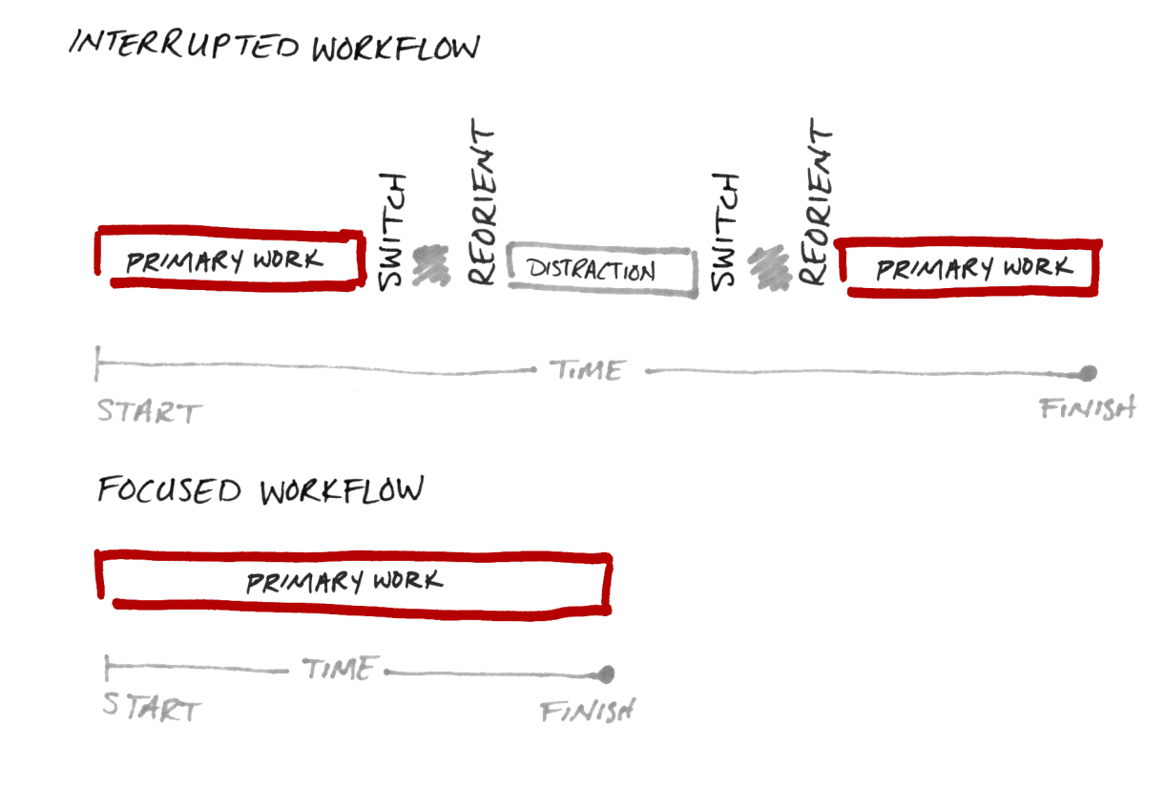
Multi-tasking = Switch Tasking

Slide 10
Truth
Trying to do two things at once is a terrible idea. Although is may seem possible to do, it’s never possible to do it effectively.

Slide 11
I just need to be a more disciplined person.
You don’t need to be a disciplined person to be successful.

Slide 12
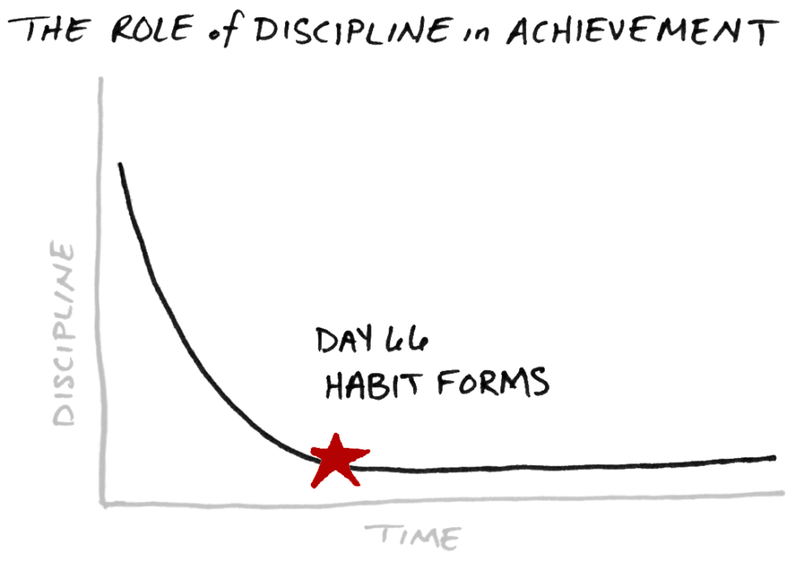
Selective Discipline → Habit

Slide 13
Truth
We don’t need any more discipline than we already have. We just need to direct and manage it a little better.

Slide 14
Where there’s a will there’s a way
Willpower is not always on call
Notes:
I should be able to do whatever I want, whenever I want.

Slide 15
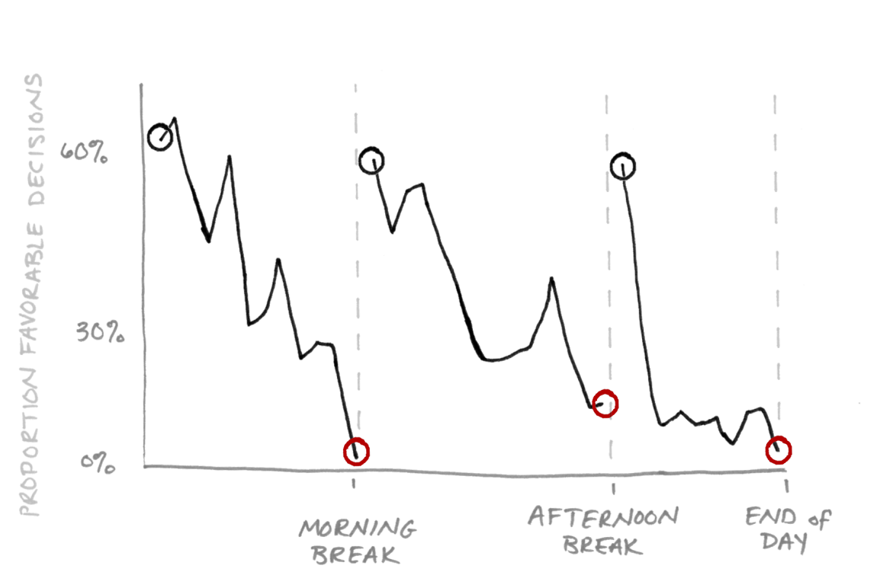
Willpower is a timing issue

Slide 16
Truth
For extraordinary results, make doing what matters most a priority when your will power is highest.

Slide 17
I need to achieve a balanced life
A balanced life is a myth

Slide 18
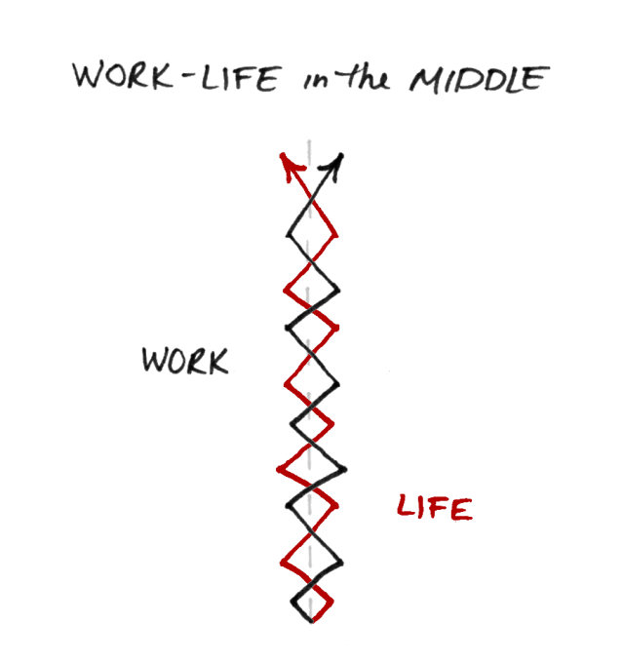
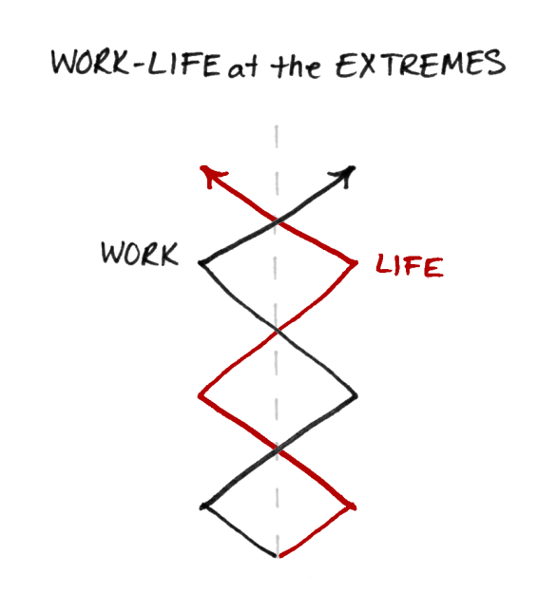
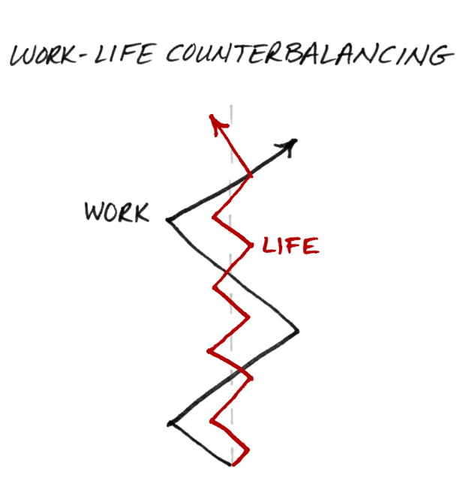
Life IS a Balancing Act

Slide 19
The challenge doesn’t become one of not going out of balance, for in fact you must.
Truth
The challenge becomes how long you stay on your priority.
Counterbalance
Notes:
Counter balance

Slide 20
Maybe I shouldn’t dream so big
No one knows their ultimate ceiling for achievement

Slide 21
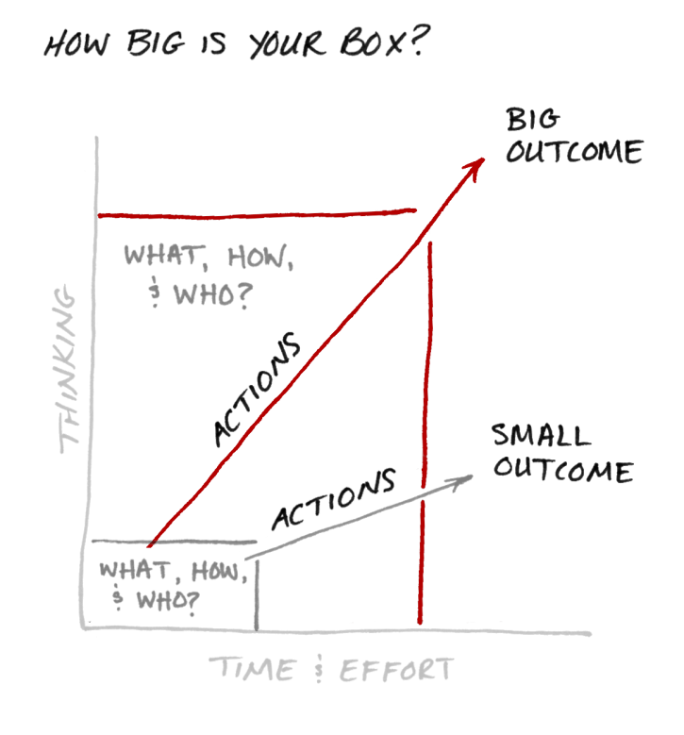
Think Big. Act Big. Succeed Big

Slide 22
Truth
The only actions that become springboards to succeeding big are those informed by big thinking to begin with.

Slide 23
Your turn!
The Six Lies
Balanced Life
Everything matters equally
Multitasking
More discipline
Willpower is always available
Big is bad
Do you buy what Keller is selling?
Were you surprised by any of the “lies”?
Is there a particular “lie” that really resonates with you?
How do you see any of these lies affecting how you work?

Slide 24
The Truth
The simple path to productivity

Slide 25
The Focusing Question

Slide 26
Ask a great question Find a great answer
What’s the ONE Thing I can do to ensure that I hit my goals?
What’s the ONE Thing I can do to improve my skills?
What’s the ONE Thing I can do to help my team succeed?
What’s the ONE Thing I can do to further my career?
Notes:
Think big and specific

Slide 27
Extraordinary Results
Unlocking the possibilities within you

Slide 28
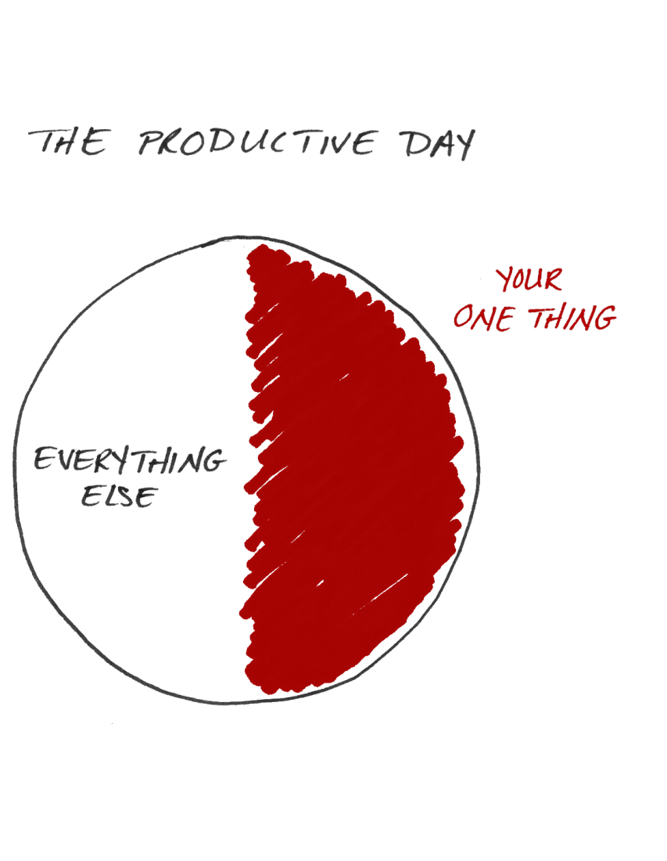
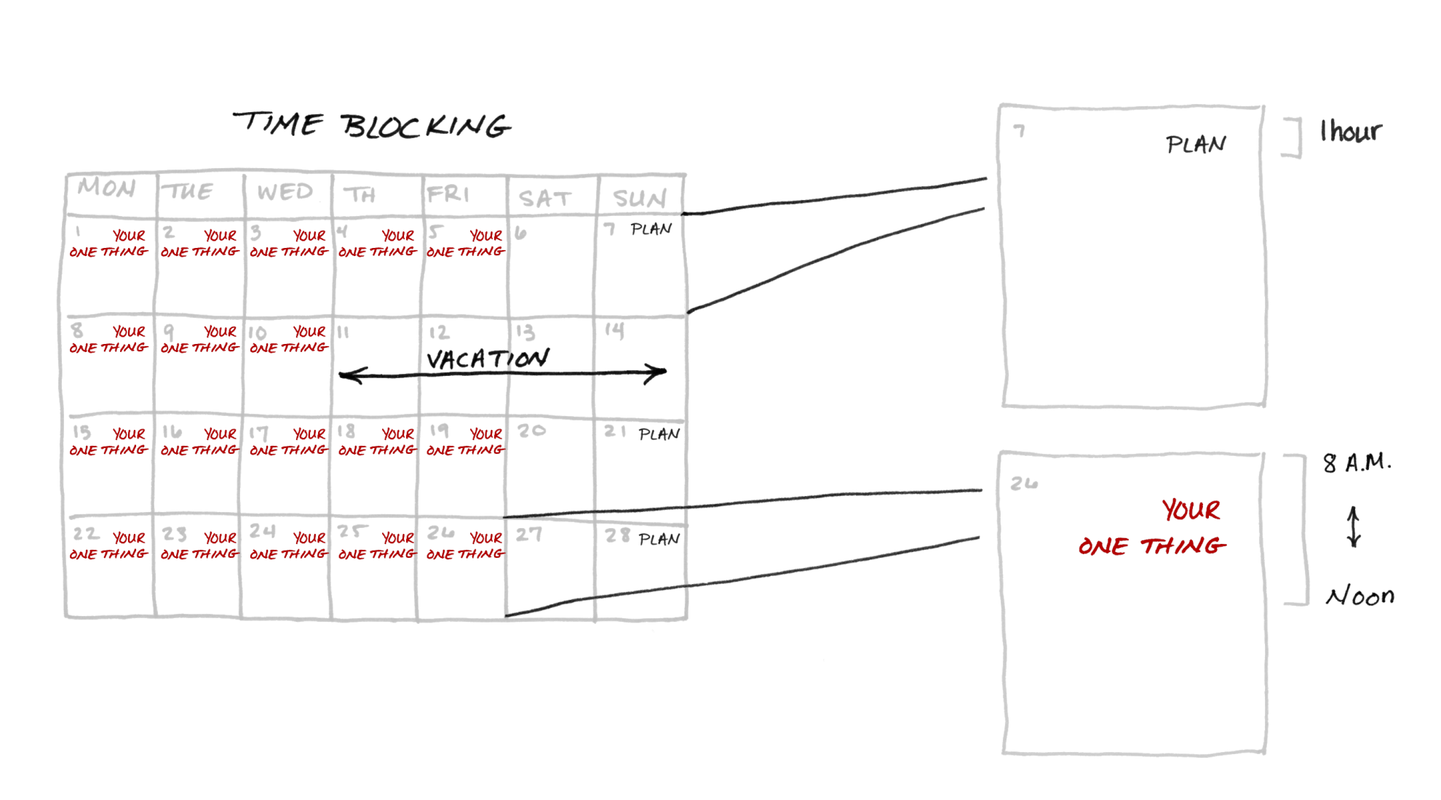
Time Blocking

Slide 29
Three Commitments
1. Follow the path of mastery
2. Continually improve
3. Be accountable

Slide 30
4 Thieves
1. Inability to say no
2. Fear of chaos
3. Poor health habits
4. Your environment doesn’t support your goals

Slide 31
Your turn!
The Four Thieves
Inability to say no
Poor health habits
Environment doesn’t support goals
Fear of Chaos
Which thief resonates most with you?
How does it affect your productivity?
Have you found ways to navigate around it?

Slide 32
One Minute Takeaway

