Slide 1
Biases,
Misinformation,
&
Regulating Humans:
Examining the Use of AI in the Legal Field
JILL L. KILGORE & AUTUMN COLLIER

Slide 2
AI is Necessary.
JUDICIAL OPINIONS.
IT'S ALREADY BEING USED.
AVOIDANCE DOES NOT PROTECT US FROM BIAS.
USING AI CAN PROTECT US FROM HUMAN ERROR AND EXPOSE BIAS.
Collier & Kilgore | MAALL 2019

Slide 3
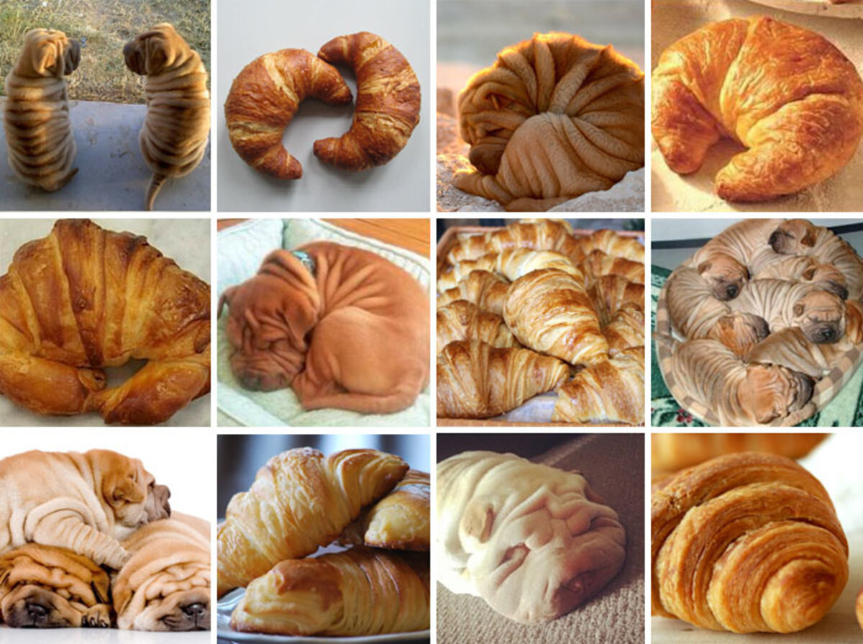

Slide 4
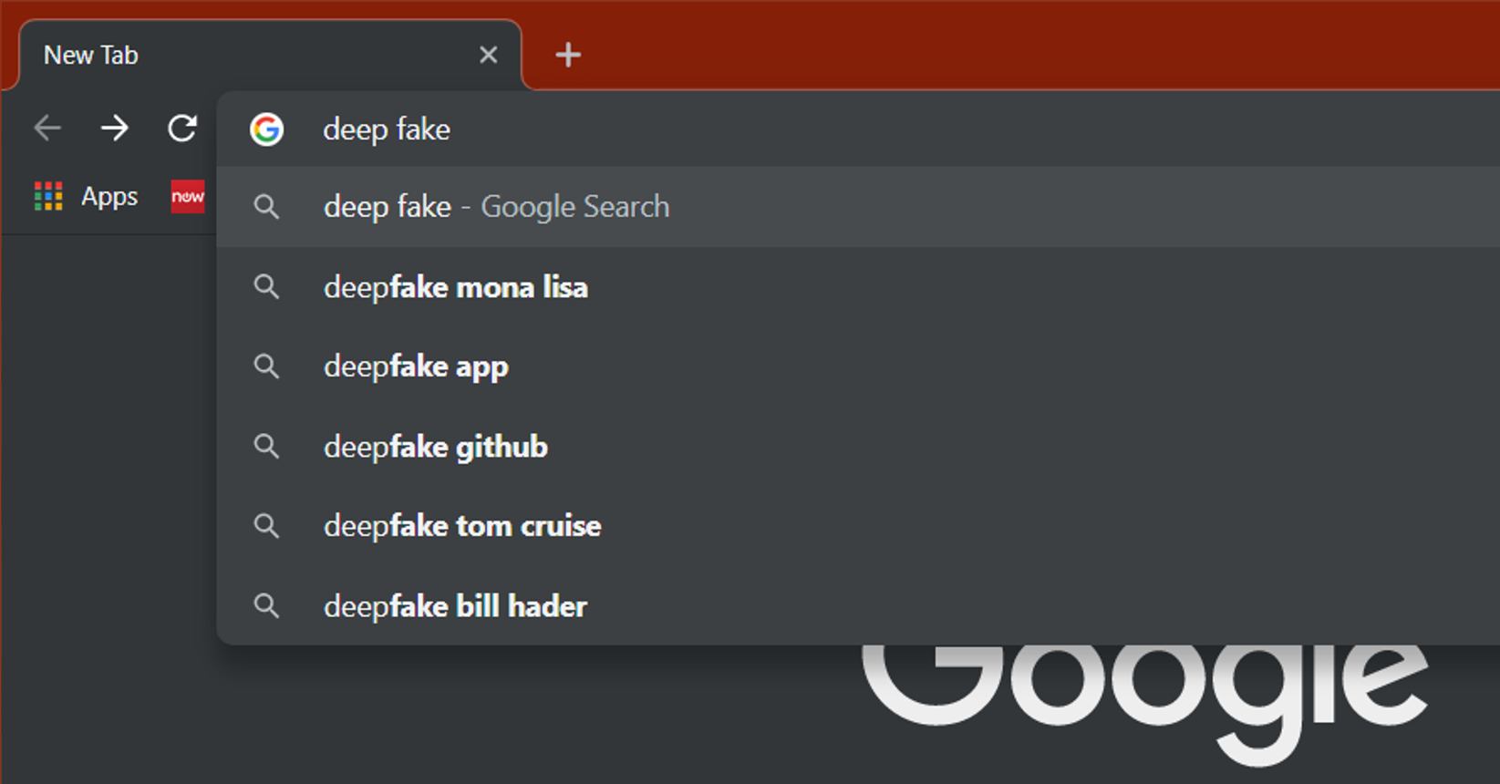
Collier & Kilgore | MAALL 2019

Slide 5
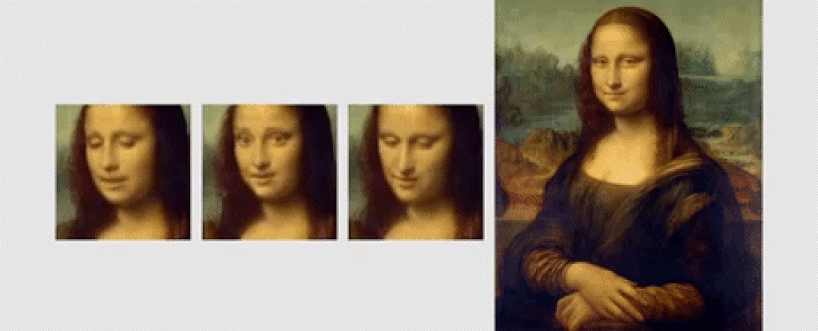
Collier & Kilgore | MAALL 2019
Notes:
https://www.youtube.com/watch?v=P2uZF-5F1wI

Slide 6
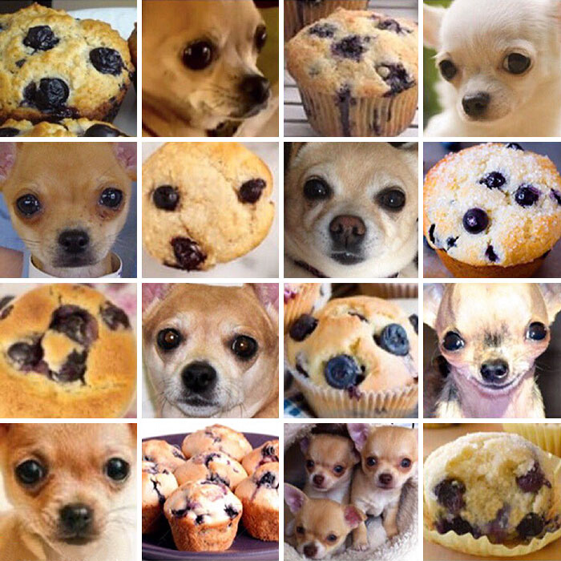
Collier & Kilgore | MAALL 2019

Slide 7
Perpetuating Discrimination
PHOTOS & COLOR FILM
FACIAL ANALYSIS
DEEP FAKES
APPLE WATCH
Deep fakes weaponized against women - pornography and harassment.
New Zealand's passport robot & Nikon Camera.
Color film designed for light-skinned people.
Determines heart rate based on how much light is absorbed through the skin.
AI systems fail to correctly analyze faces of darker-skinned women than that of lighter-skinned men.
Collier & Kilgore | MAALL 2019

Slide 8
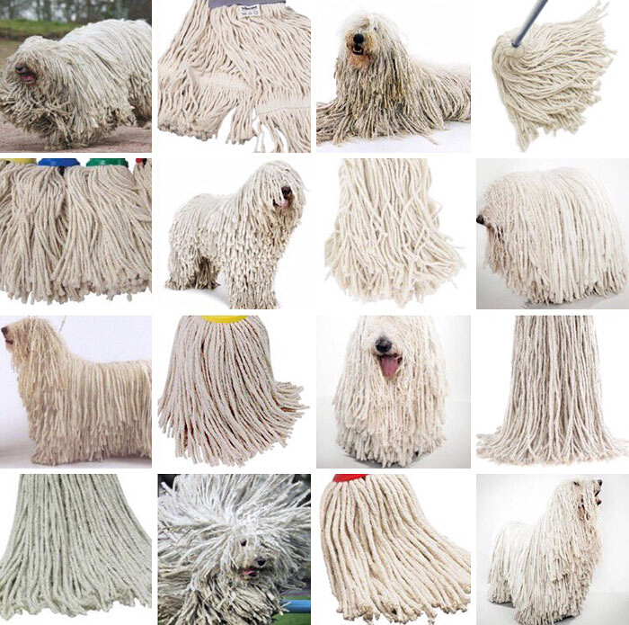
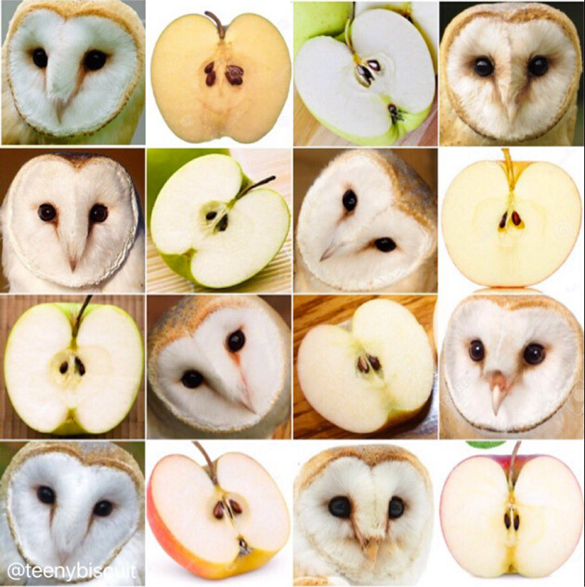
Collier & Kilgore | MAALL 2019

Slide 9
Regulating Humans:
Resolving Problems of AI
Diversity in the workplace
Numbers in the workplace
- BROADENING THE PERSPECTIVES IN THE WORKPLACE (DEMOGRAPHICS)
- SOME ISSUES MAY NOT OCCUR WITH MORE VOICES AT THE TABLE
- ADDING A SINGLE PERSON CAN CREATE MORE ISSUES THAN IT SOLVES ("TOKENISM")
Collier & Kilgore | MAALL 2019

Slide 10
Human Cognition
is the ultimate
"Black Box"
Collier & Kilgore | MAALL 2019

Slide 11
Misinformation
INFORMATIONAL
HOLES
UNREPRESENTED OR
UNDERREPRESENTED
DATA ENTRY
ERRORS
CONFIRMATION
BIAS
Collier & Kilgore | MAALL 2019

Slide 12
Misinformation
How does it impact us?
Affects and skews results & information.
Produces more of the same with AI as an intermediary.
Perpetuates human bias and compromises accuracy.
Collier & Kilgore | MAALL 2019

Slide 13
Determining
Bias
DISCRIMINATION & BIAS
Not just technical issues.
DISCRIMINATION IS PROHIBITED
American Law prohibits discrimination on protected classifications.
PROVE BIAS BY EXAMINING MOTIVATION
Disparate Treatment & Disparate Impact
Collier & Kilgore | MAALL 2019

Slide 14
U.S. Legislation
2019-2020 Session
ILLINOIS
HB 2557
ILLINOIS
HB 3415 & 2991
NEW YORK
HB 7989
Requires that applicants be notified that employers will use AI to analyze video interviews.
(Enacted)
Prohibits the use of predictive analytics to provide information on mailing addresses - relates to race/income.
(Introduced)
Requires the regulation of AI used for hiring to ensure that it is not discriminating.(Introduced)
Collier & Kilgore | MAALL 2019

Slide 15
France bans the use of
Judicial Analytics.
"The identity data of magistrates and members of the judiciary cannot be reused with the purpose or effect of evaluating, analysing, comparing or predicting their actual or alleged professional practices."
40
30
20
10
0
Item 1
Item 2
Item 3
Item 4
Item 5
Implications?
Collier & Kilgore | MAALL 2019

Slide 16
Disenfranchisement
Whose voices are being stifled?
Collier & Kilgore | MAALL 2019

Slide 17
Who is using/creating AI?
Who is being hurt by the problems in AI?
Collier & Kilgore | MAALL 2019

Slide 18
AI is not biased...
It's a scapegoat.
Collier & Kilgore | MAALL 2019

Slide 19
AI is not biased...
It's a scapegoat.
Collier & Kilgore | MAALL 2019

Slide 20
AI is not biased...
It's a scapegoat.
Collier & Kilgore | MAALL 2019

Slide 21
Regulating Humans
AI EXPOSES THE BIASES THAT EXIST WITHIN THE DATA.
RESOLUTION COMES FROM REGULATING PEOPLE, NOT JUST REGULATING AI.
INHERENT BIASES ARE EMBEDDED IN OUR CULTURE.
Collier & Kilgore | MAALL 2019

Slide 22
Therefore...
AI IS HUMAN.
Collier & Kilgore | MAALL 2019

Slide 23
Algorithm
Flowchart
"REALITY"
People create
Algorithms
People
are biased
Algorithms
are biased
Regulation
Disenfranchisement
Perpetuates
Discrimination
Collier & Kilgore | MAALL 2019

Slide 24
Algorithm
Flowchart
ELIMINATING
ISSUES
X
People create
Algorithms
People
are biased
Algorithms
are biased
X
X
Regulation
Disenfranchisement
Perpetuates
Discrimination
Collier & Kilgore | MAALL 2019

Slide 25
Algorithm
Flowchart
People create
algorithms
X
RESOLUTION
Algorithms
are biased
People are
biased
X
Perpetuates
discrimination
X
Regulation
Disenfranchisement
Collier & Kilgore | MAALL 2019

Slide 26
Gift or Burden
DUTY TO EDUCATE AND TRAIN
UNDERSTAND HOW AI FITS
IT'S THE LAW
Collier & Kilgore | MAALL 2019

Slide 27
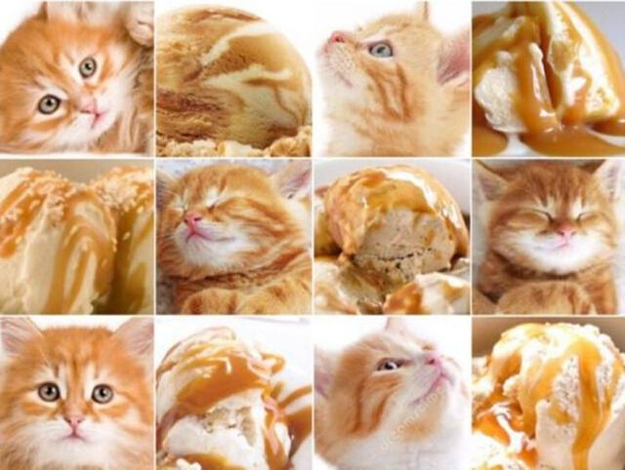

Slide 28
Questions? Comments?
LET US KNOW!
AUTUMN COLLIER JILL L. KILGORE
ACollier@Littler.com
JLKilgore@Littler.com
Collier & Kilgore | MAALL 2019

Slide 29
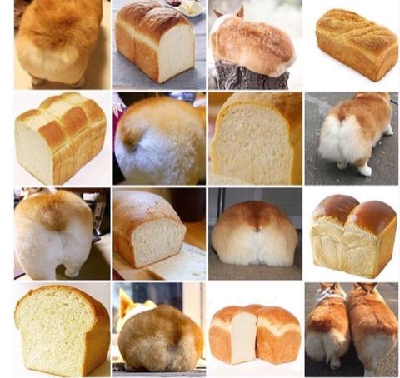
ollier & Kilgore | MAALL 2019

